Slide 1
Making continua with Praat

Slide 2
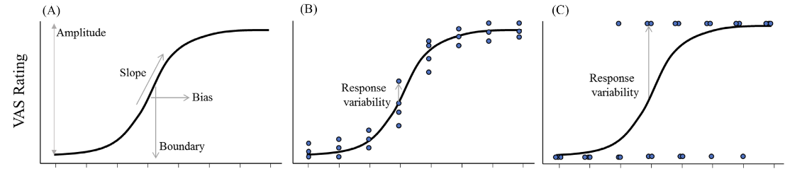
Degree of categorization gradiency can be measured from visual analog scale (VAS) slope and response variability
(Apfelbaum et al., 2022)
Notes:
First, as a reminder, categorization gradiency can be measured through the visual analog scale task, and gradiency can be operationalized using the measurements of slope and response variability

Slide 3
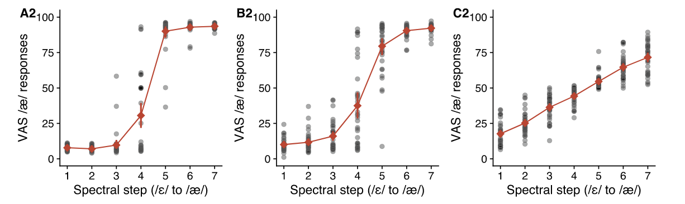
Some individuals respond more categorically, while others respond more gradiently
More categorical
More gradient
(Kim et al., 2020)
Notes:
using the VAS task, we see that there are individual differences in the degree of categorization gradiency for a given phonemic contrast, with some individuals responding more categorically, others responding more gradiently, and some individuals landing somewhere in-between

Slide 4
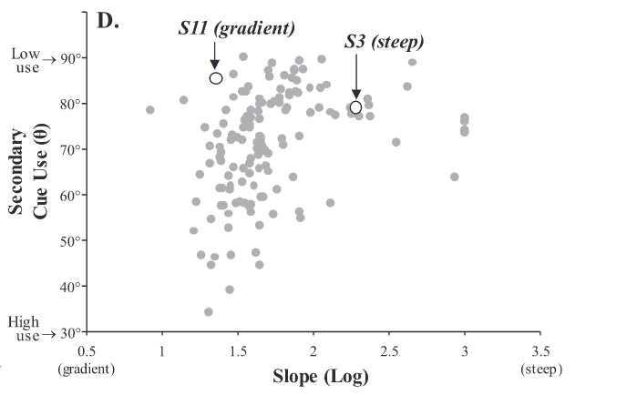
More gradient categorization is typically associated with increased secondary cue integration in L1 speech perception
(Kapnoula & McMurray, 2021)
Notes:
Another pertinent observation is that more gradient perception is typically associated with increased secondary cue integration. Although speech can be mostly categorized using the primary acoustic cue, the most optimal speech categorization occurs when integration multiple acoustic cues

Slide 5
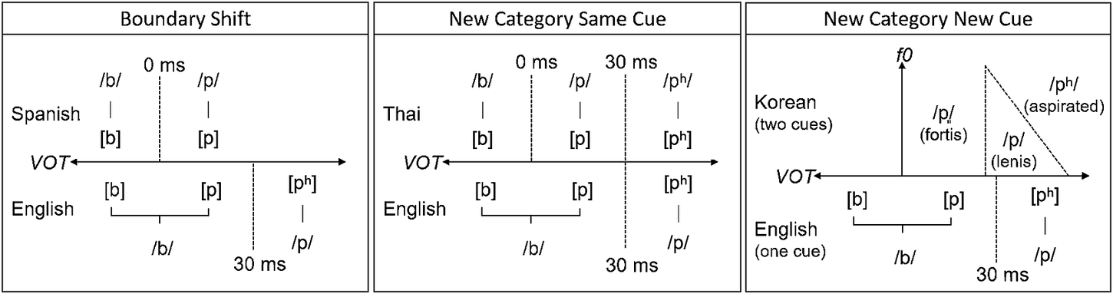
Multiple cue integration, cue sensitivity, and perceptual flexibility is advantageous for learning novel L2 speech categories
Nagle & Baese-Berk (2022)
Notes:
This is relevant for L2 speech category learning because L2 perceptual learning involves reorganizing the speech perceptual space, and based on the learning scenarios we discussed before, we can see that integrated multiple cues, sensitivity to acoustic cues, and overall perceptual flexibility are all necessary for successful reorganization

Slide 6
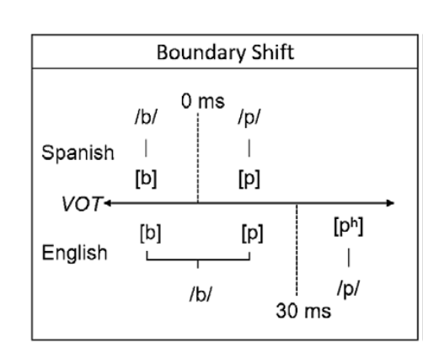
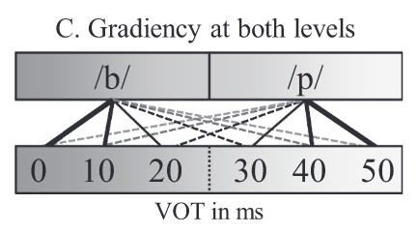
There may be a bidirectional relationship between gradient categorization and mutlilingualism, connected through perceptual flexibility
25 ms
(Nagle & Baese-Berk, 2022)
(Kapnoula & McMurray, 2021)
Notes:
It may be the case that there is a bidirectional relationship between gradient categorization and multilingualism. Being multilingual or being exposed to linguistic diversity may encourage gradient perception such that being familiar with different languages that have different perceptual boundaries enables a person to move around their own perceptual boundary as necessary depending on their language demands, also known as perceptual flexibility. In the other direction, as we discussed, this perceptual flexibility, encouraged through gradient perception, may make it easier to learn novel L2 speech categories, making it easier to become multilingual, to put it broadly
[audio: Thus, we can predict that by being familiar with different languages that have different perceptual boundaries, that enables a person to move around their own perceptual boundary as necessary depending on their language demands. This is called perceptual flexibility]

Slide 7
Perceptual task: L1 and L2 VAS
2-dimensional continua between words with contrasting phonemes that vary along primary and secondary acoustic dimensions
7 steps along primary dimension, 5 steps along secondary dimension
2 continua in English, 2 continua in Japanese
reason [i] vs. risen [ɪ]
indent [d] vs. intent. [t]
toru [o] vs. tooru [oː]
kata [t] vs. katta [tː]

Slide 8
indent
intent
Click on the slider based on what you think the word sounded like, then press the Spacebar to continue.
Notes:
English VAS

Slide 9
risen
reason
Click on the slider based on what you think the word sounded like, then press the Spacebar to continue.
Notes:
English VAS

Slide 10
かた
kata
かった
katta
Click on the slider based on what you think the word sounded like, then press the Spacebar to continue.
Notes:
Japanese VAS

Slide 11
とる
toru
とおる
tooru
Click on the slider based on what you think the word sounded like, then press the Spacebar to continue.
Notes:
Japanese VAS

Slide 12
Overall considerations for synthesizing speech continua
Primary/secondary perceptual acoustic dimensions
Method of interpolation (e.g., what math to get from 0 -> 50 in x number of steps)
Method of speech manipulation
Speech naturalness
Minimizing manipulation of other acoustic characteristics
Synthesizing speech from one recording vs. both recordings

Slide 13
PSOLA (Pitch-Synchronous Overlap and Add)
algorithm that allows changes to fundamental frequency and duration without changing (too much) other characteristics of speech

Slide 14

indent [d] vs. intent [t]
Primary: VOT
indent | 1 (21 ms) | 2 | 3 | 4 | 5 | 6 | 7 (83 ms)
1 (176 Hz)
2
3
4
5 (213 Hz) |  |  |  |  |  |  | intent
Secondary: Onset F0

Slide 15
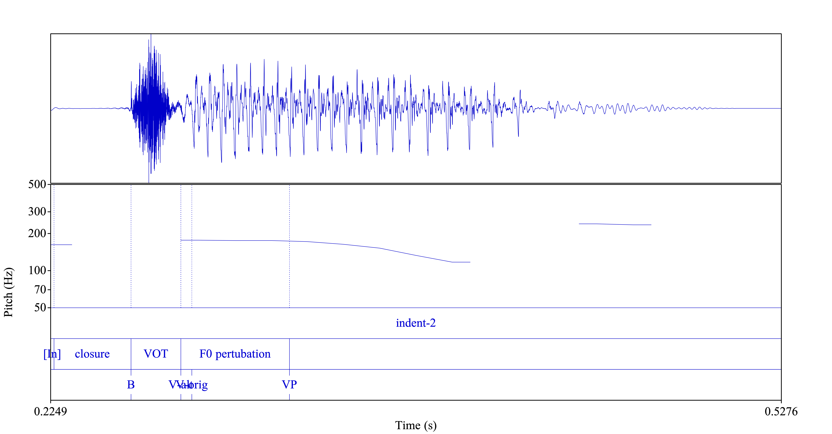
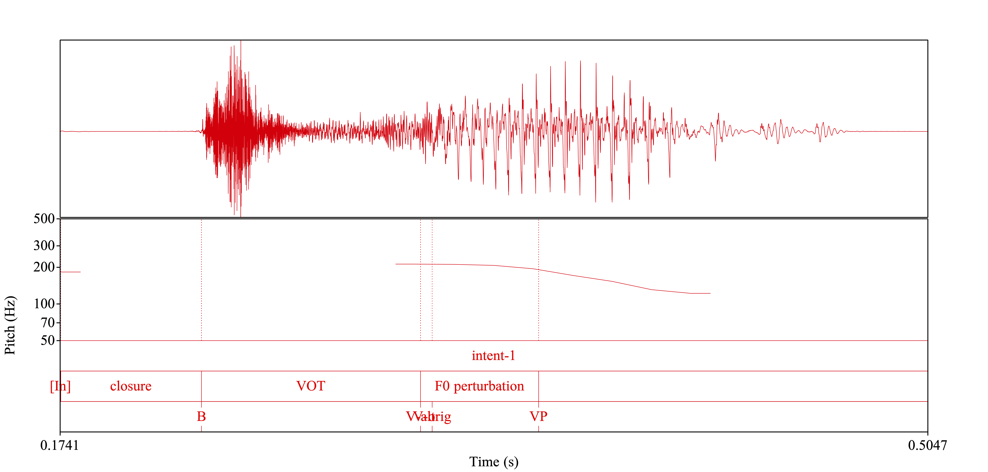
indent [d] vs. intent [t]

Slide 16
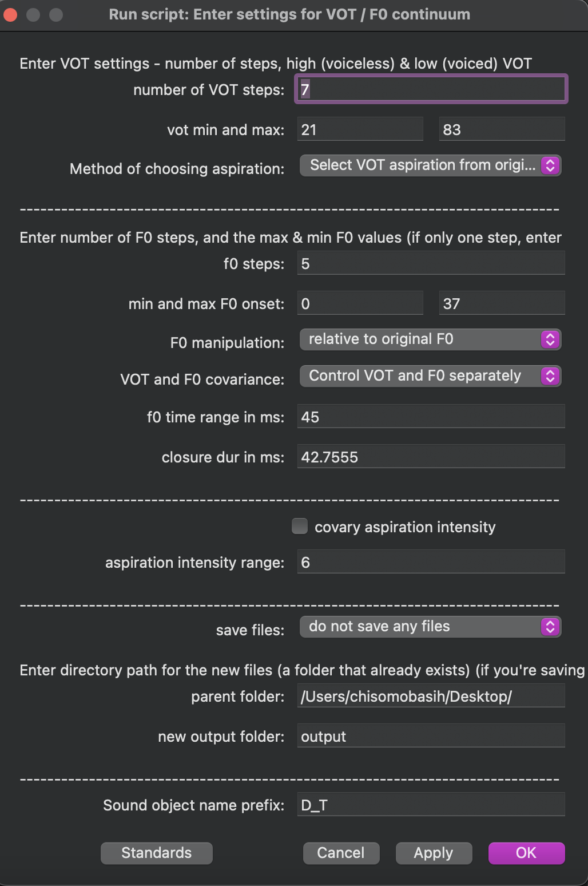
indent [d] vs. intent [t]
Considerations:
word-medial contrast, so needed to incorporate:
first syllable
intermediate pre-stop closure duration
vowel perturbation duration
Notes:
show them the script where I incorporated the first syllable and the concatenation of first syllable and constructing of pre-stop closure duration
explain vowel perturbation, going back to previous slide if necessary
email, per Matt Winn, about vowel perturbation duration:
You can control the extent of the F0 perturbation in the script startup window.
When you assumed the PSOLA algorithm would interpolate different steps of the onset F0 values to the same mid-vowel F0, this is not as accurate as I would state it. The extent of the F0 perturbation will only last as long as the time indicated in the startup window; after that number of milliseconds, the F0 contour is simply kept unchanged as it was in the original sound. So this is just to make sure you know that it is not a midpoint, and in fact not guaranteed to be within the vowel at all. You could for example, set the duration of F0 perturbation to be 125 ms, and if the vowel is only 100ms long, then it will never return to its original contour. I could also imagine a scenario where your original sound has a rising offglide for the F0 contour that simply becomes a rising contour after you cut back into the vowel.

Slide 17
reason [i] vs. risen [ɪ]
Primary: Spectral continuum (F1, F2, F3)
reason | 1 (i-like) | 2 | 3 | 4 | 5 | 6 | 7 (ɪ-like)
1 (long - 234 ms )
2
3
4
5 (short - 125 ms ) |  |  |  |  |  |  | risen
Secondary: *Vowel duration continuum

Slide 18
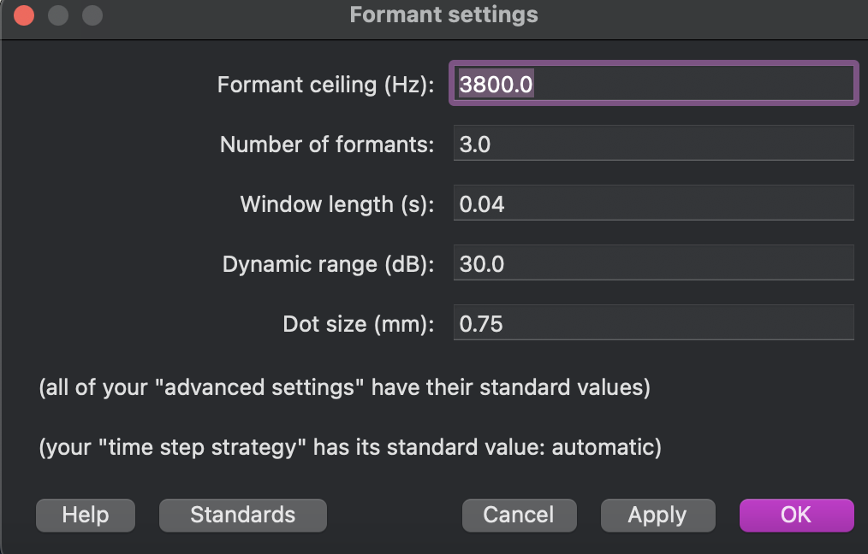
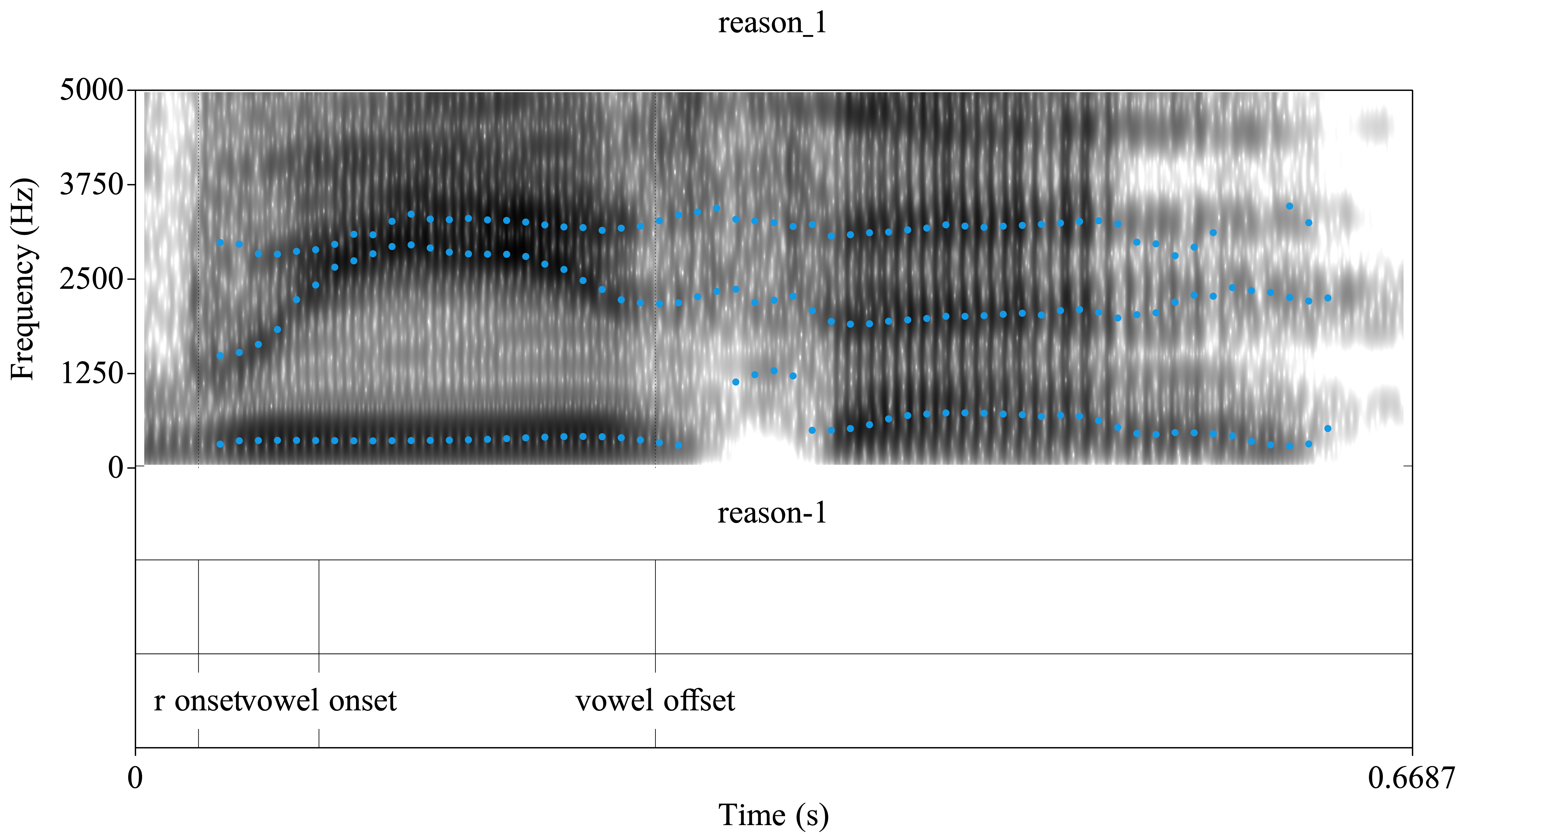
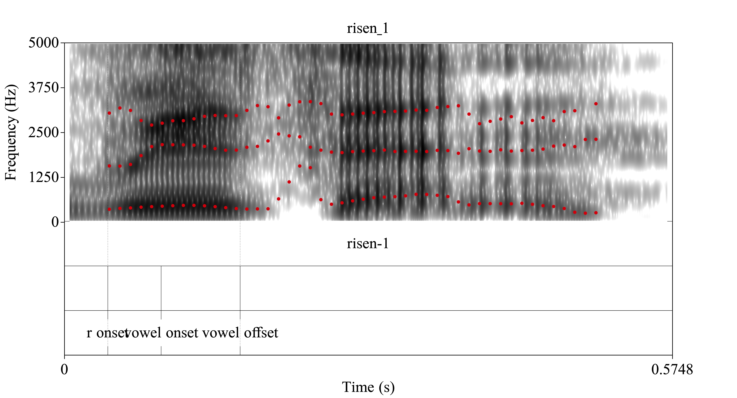
reason [i] vs. risen [ɪ]

Slide 19
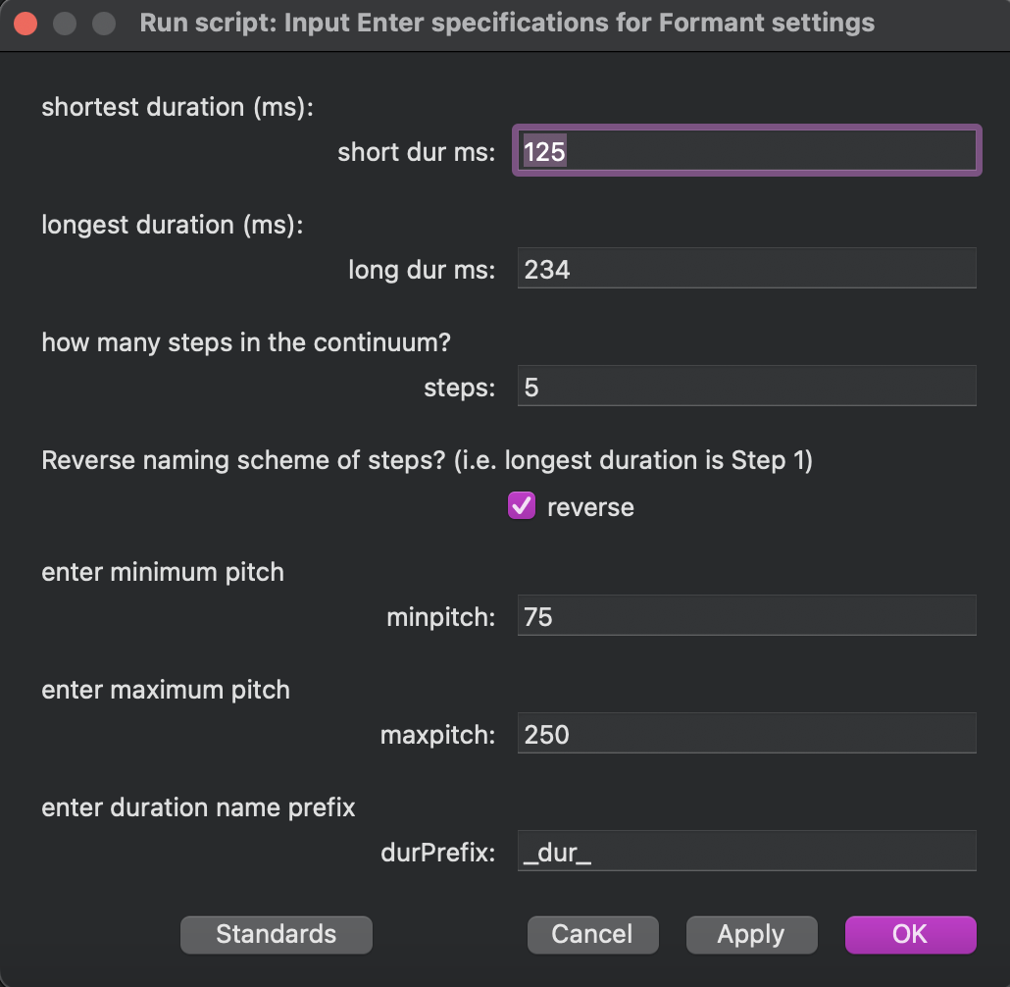
reason [i] vs. risen [ɪ]
Duration continuum – applied on each step of the spectral continuum
Spectral continuum (F1, F2, F3)
F3
F2
F1

Slide 20
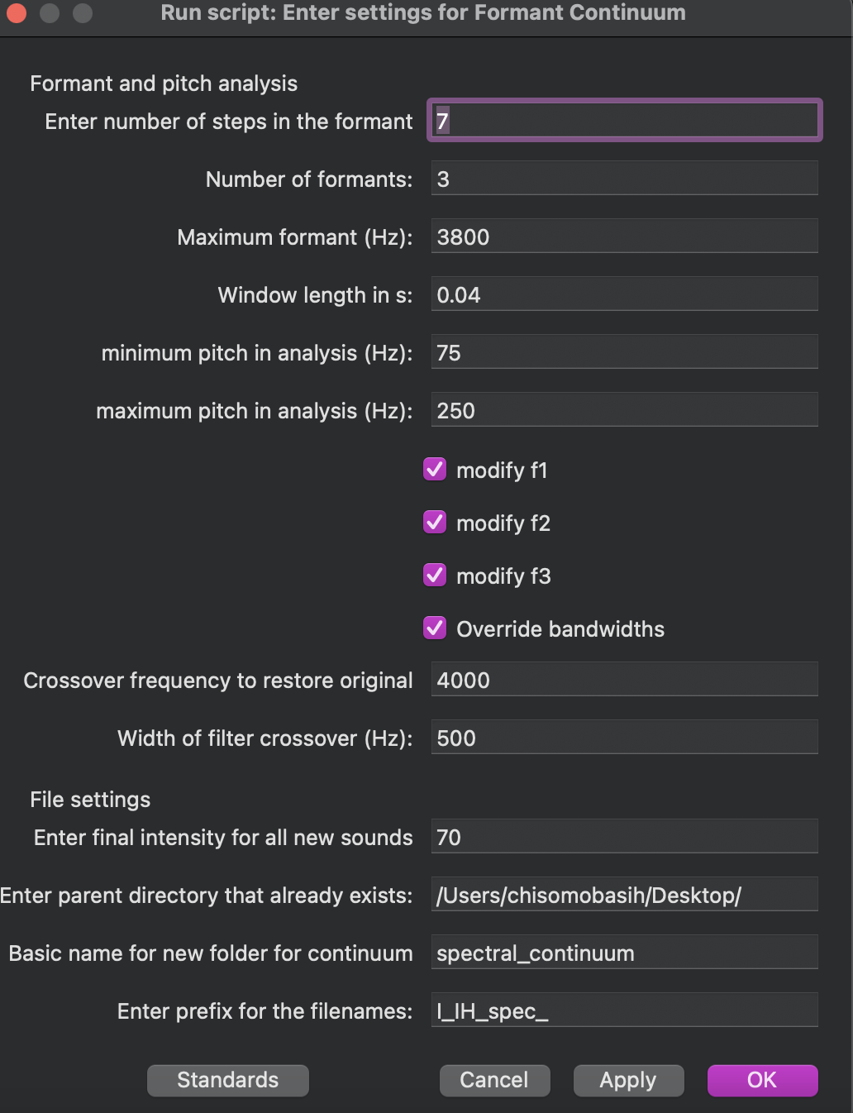
reason [i] vs. risen [ɪ]
Considerations:
inclusion of [ɹ] in vowel manipulation
pitch differences between base sound and reference sound
poor formant tracking

Slide 21
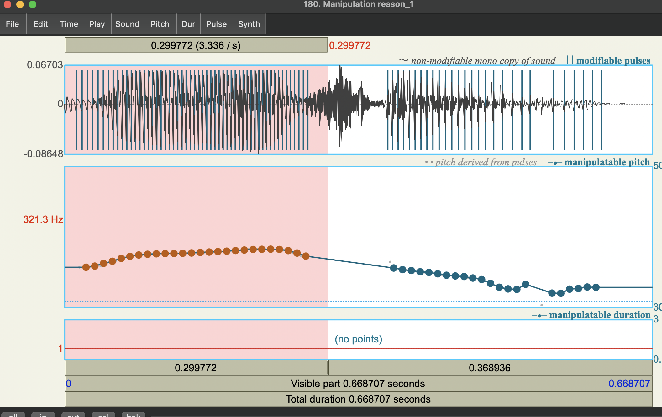
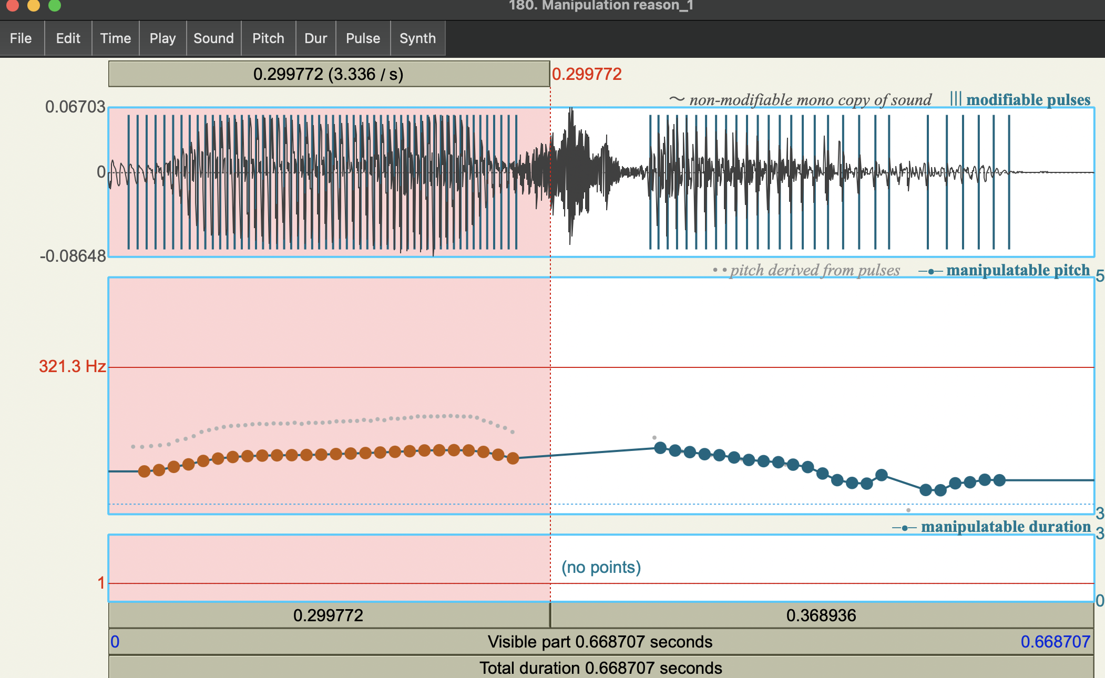
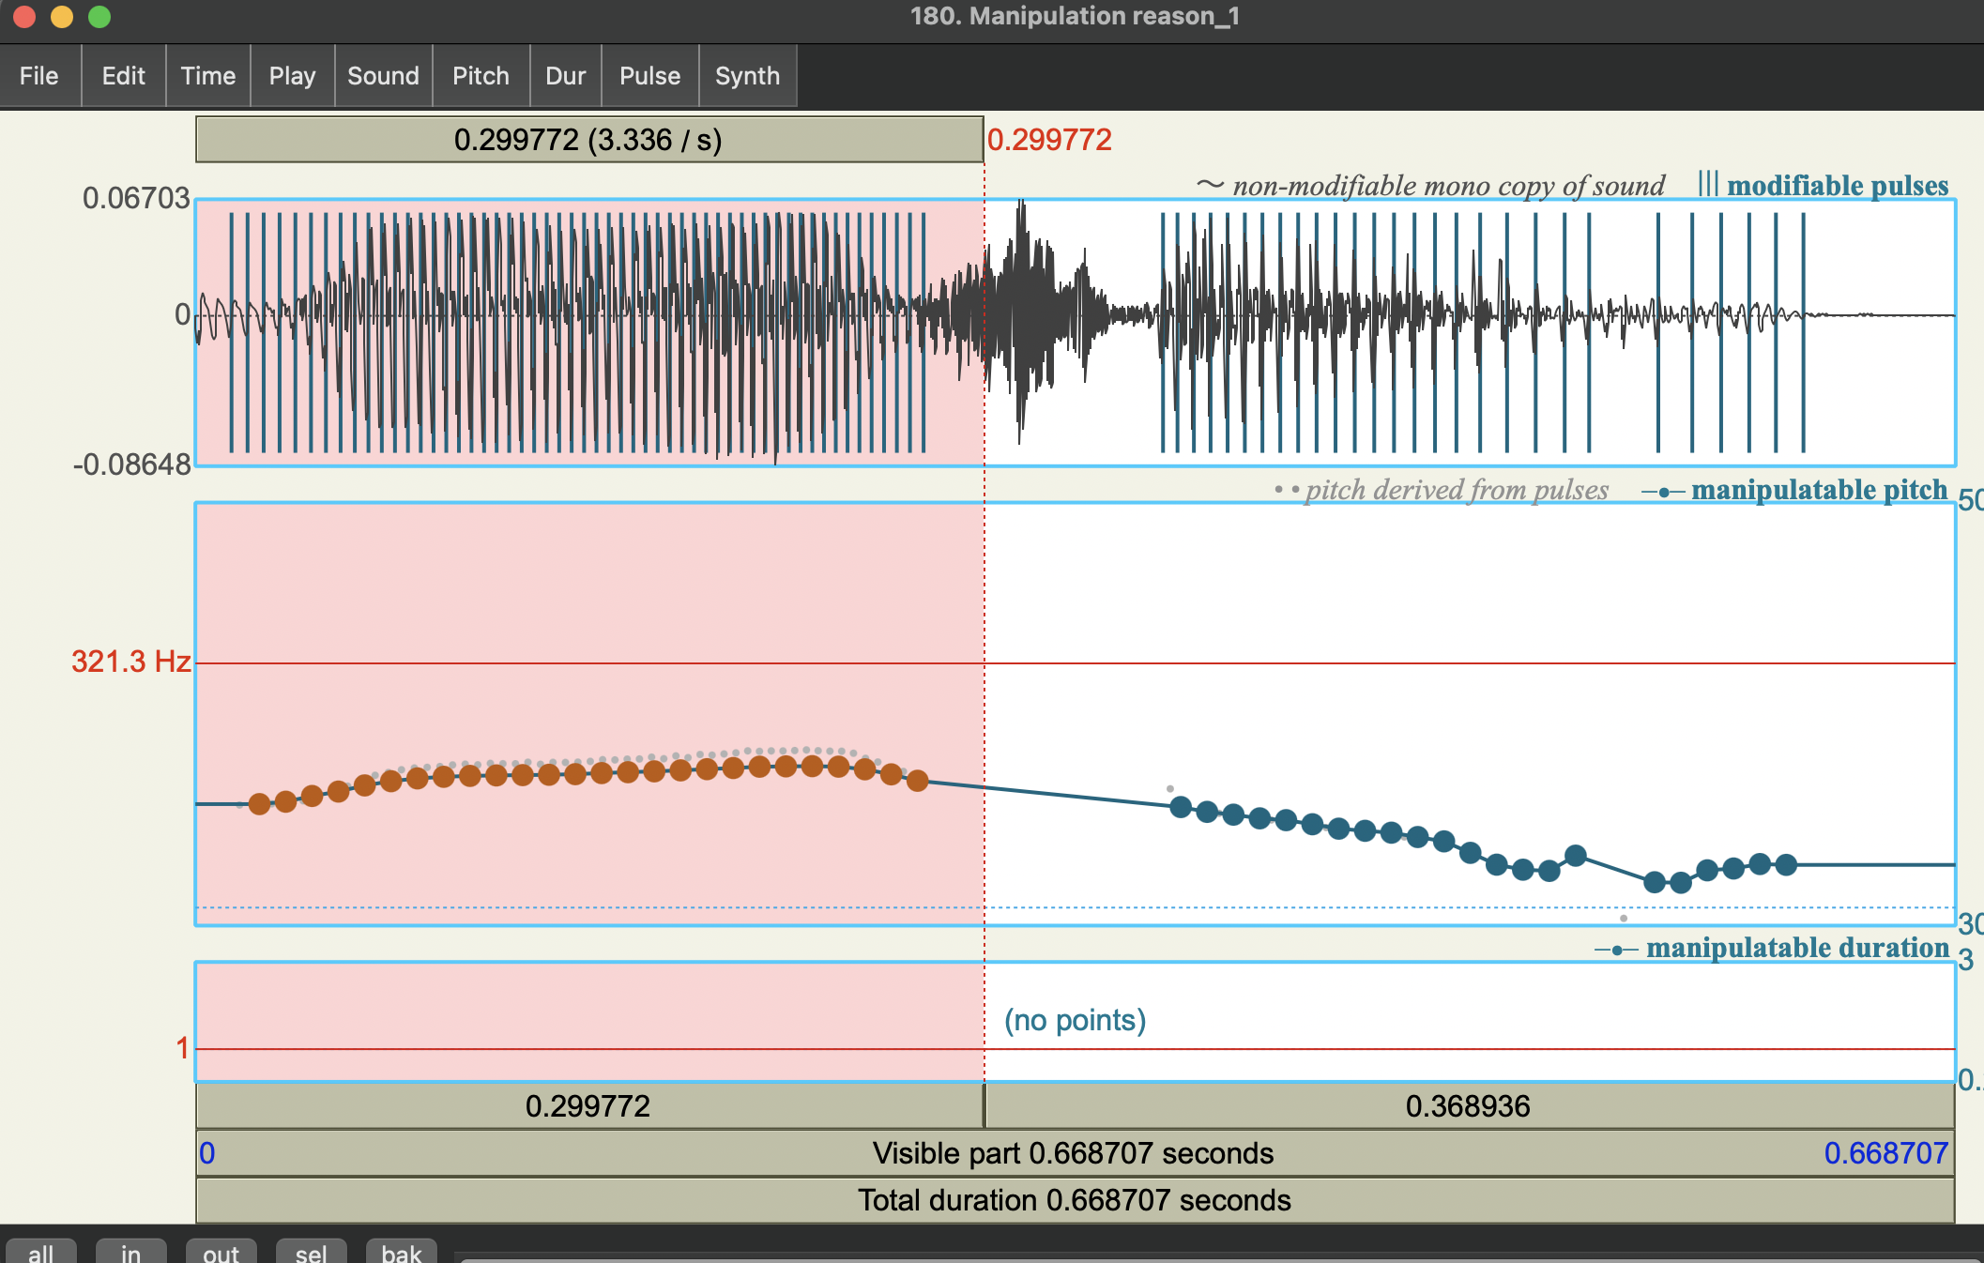
reason [i] vs. risen [ɪ]
Problems encountered:
pitch differences between base sound and reference sound
solution: manual pitch manipulation (multiply by 0.7, raise by 50 Hz)
Notes:
- present sounds from objects list

Slide 22
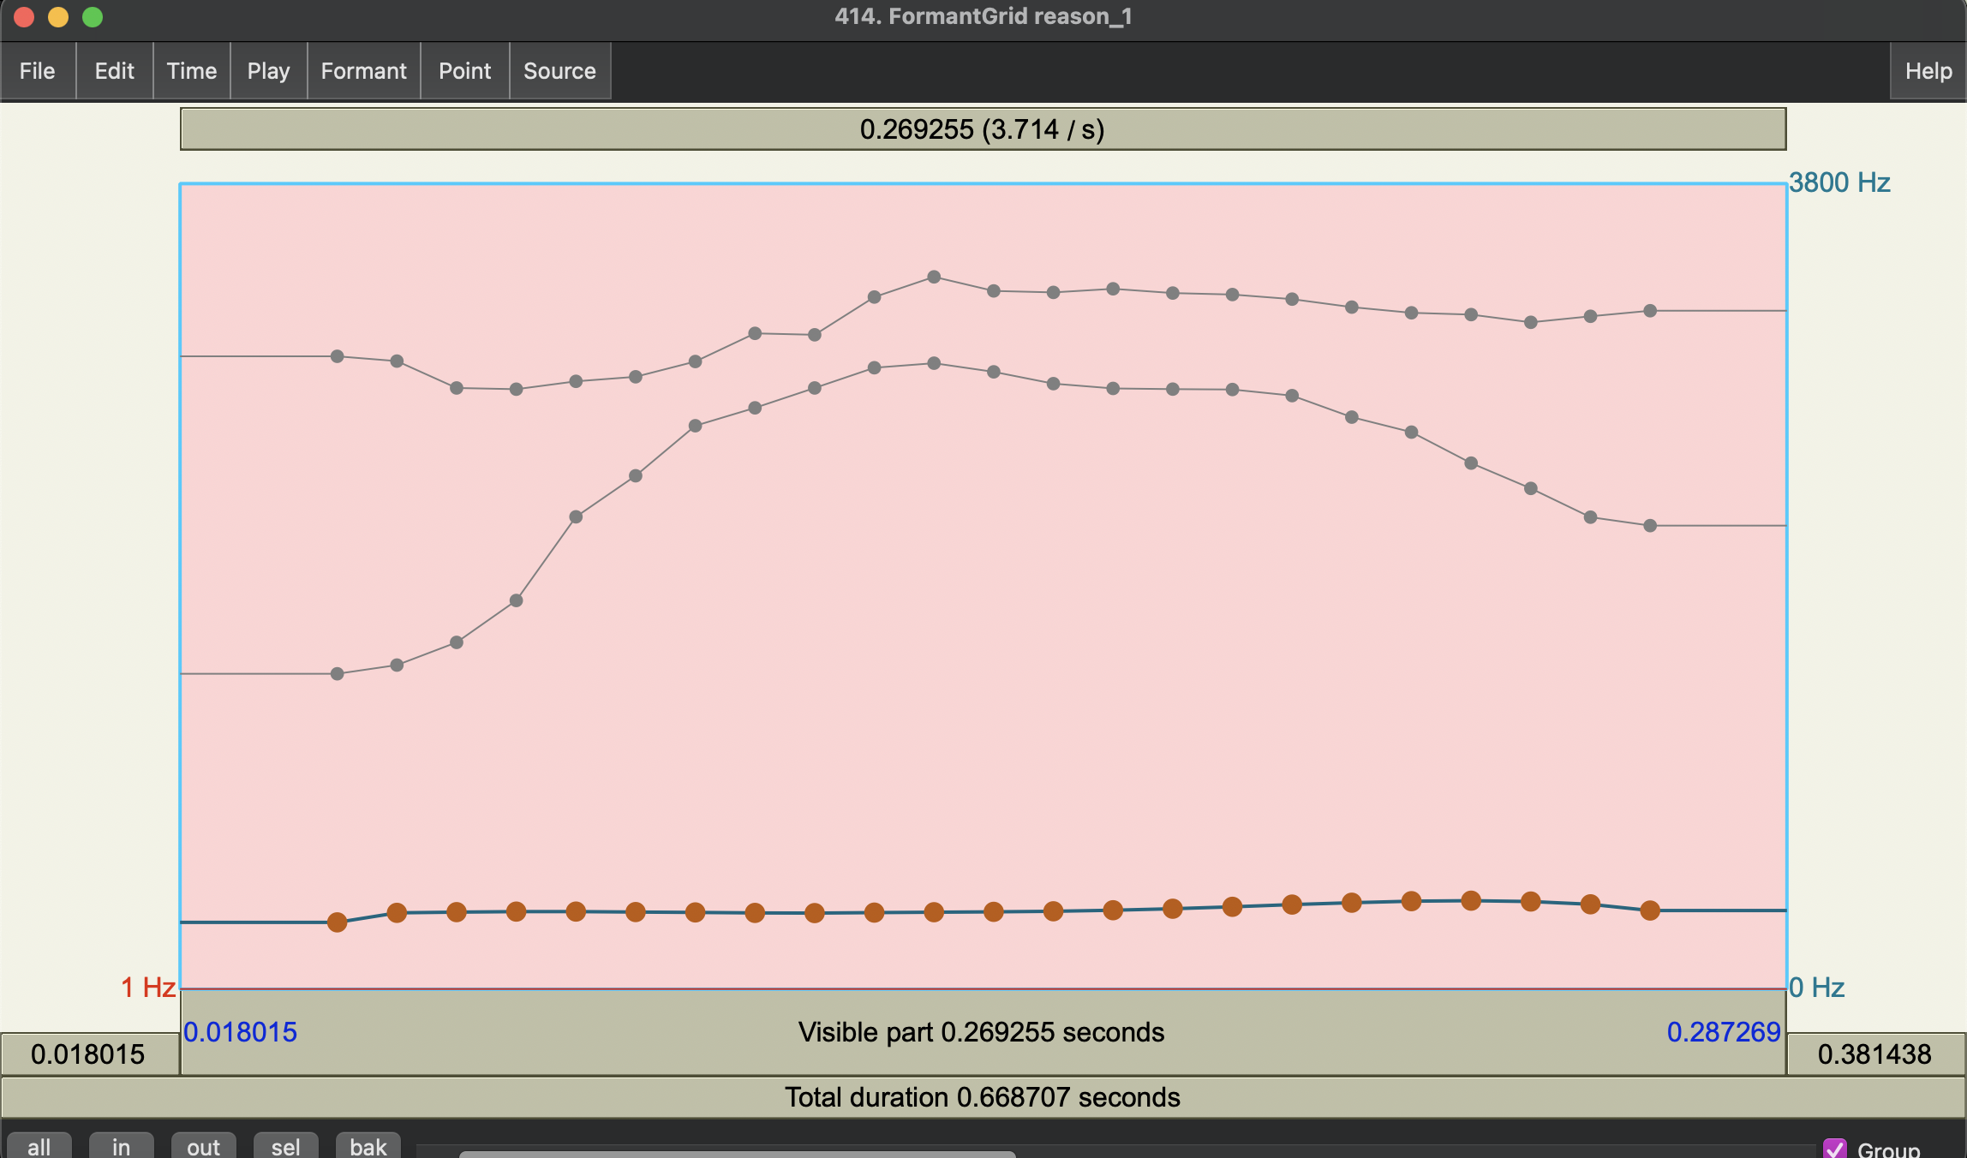
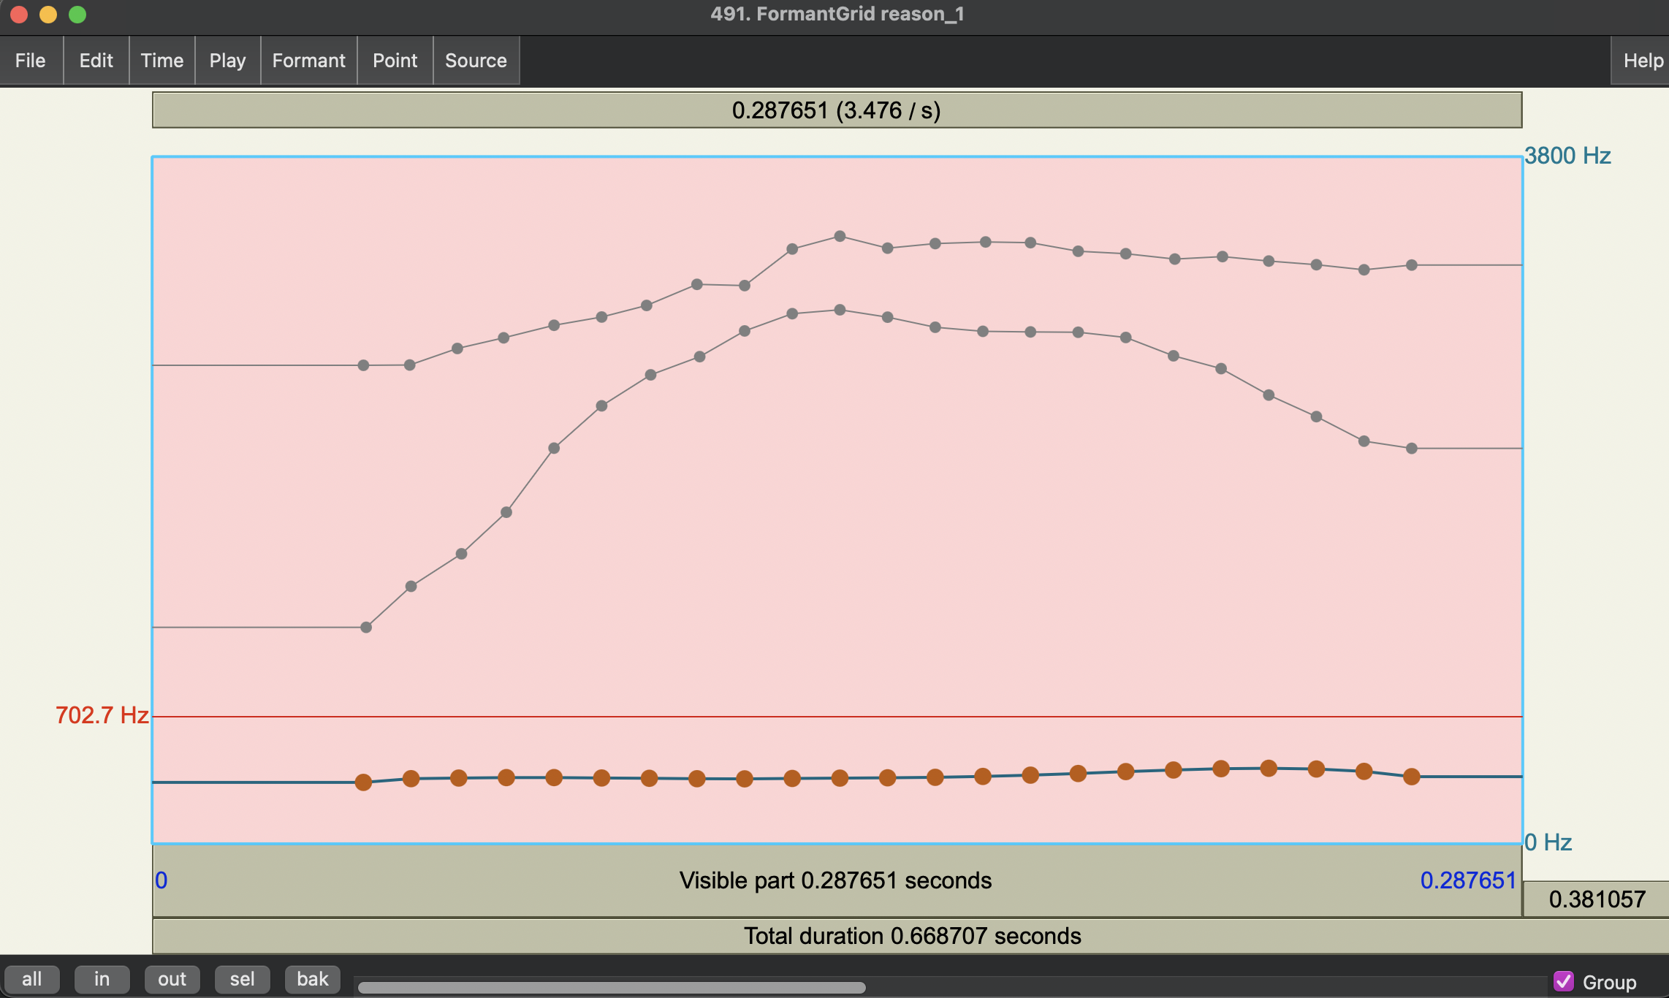
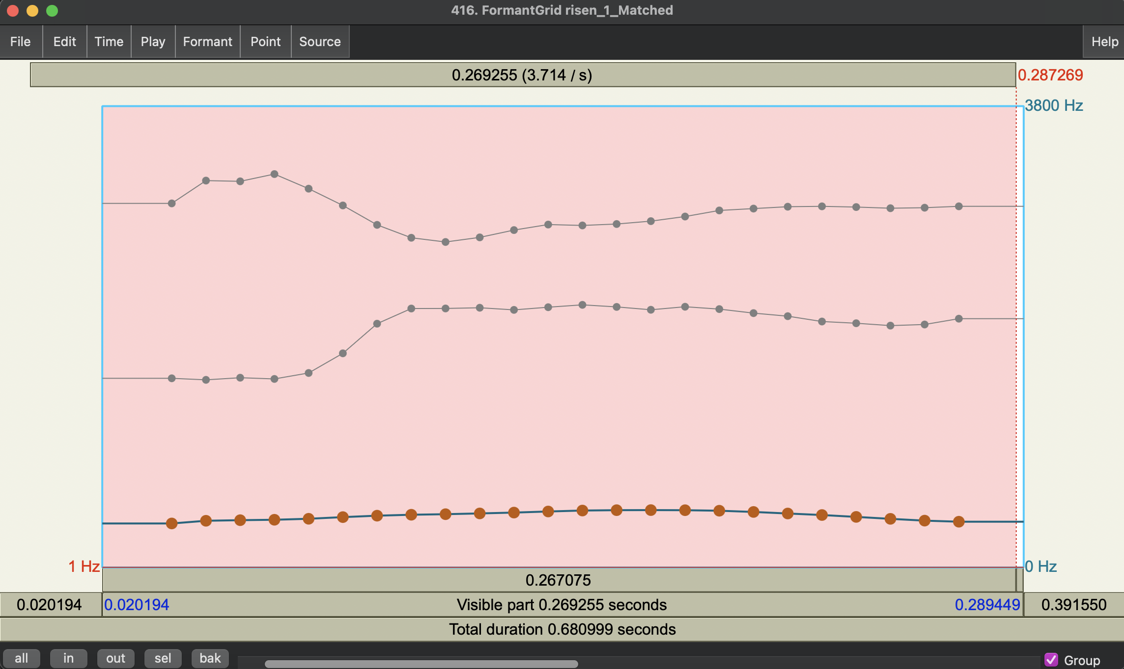
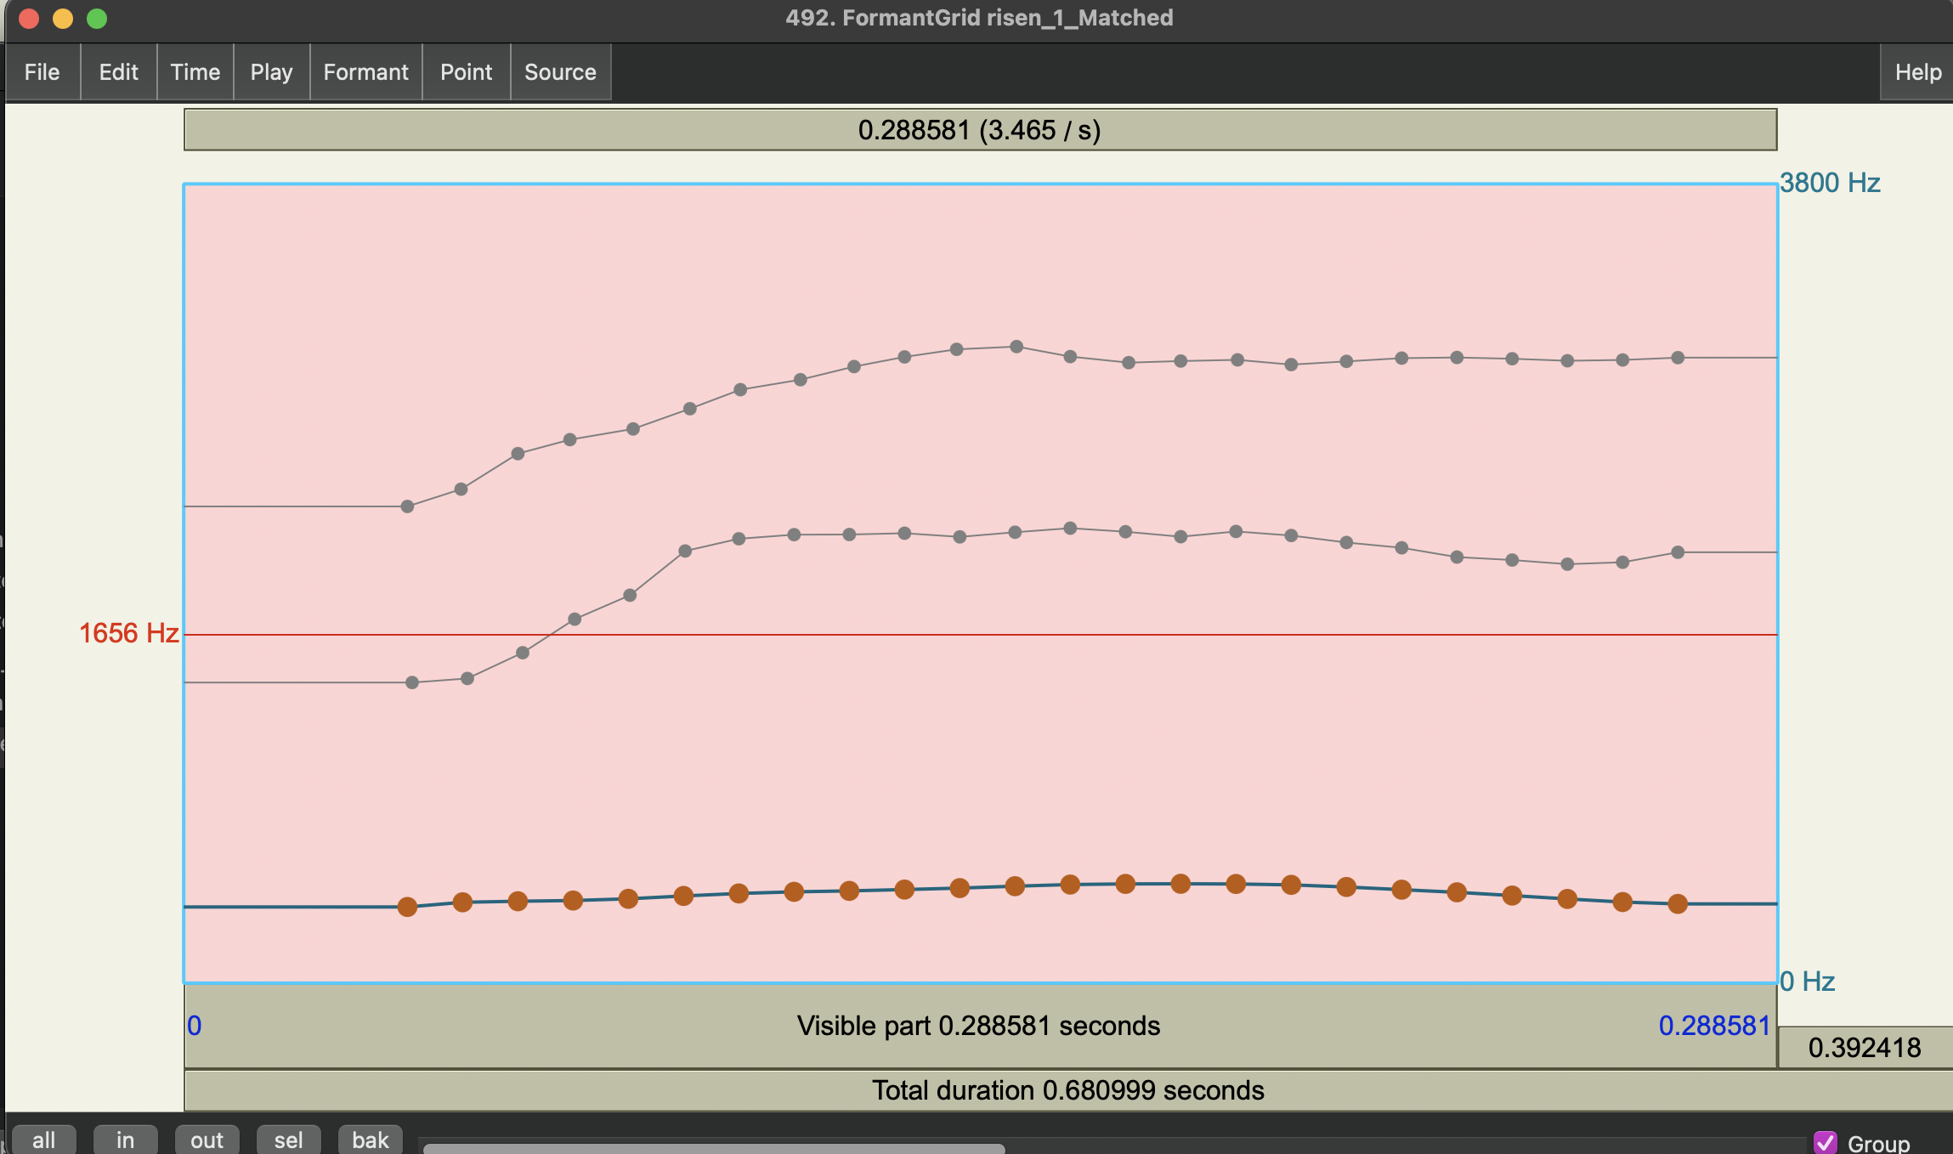
reason [i] vs. risen [ɪ]
Problems encountered:
poor formant tracking
solution: manual formant track manipulation
before
after

Slide 23
kata [t] vs. katta [tː]
Primary: Closure duration
kata | 1 (99.6 ms) | 2 | 3 | 4 | 5 | 6 | 7 (180 ms)
1 (kata-like – smaller pitch drop)
2
3
4
5 (katta-like – larger pitch drop) |  |  |  |  |  |  | katta
Secondary: Pitch drop

Slide 24
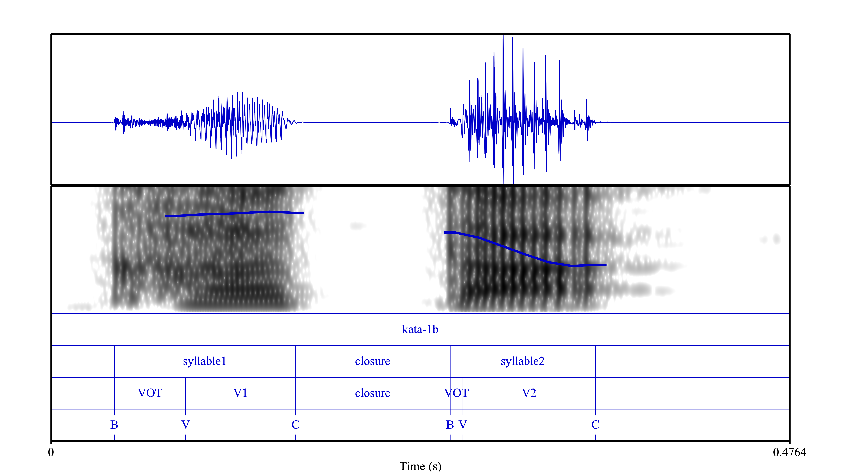
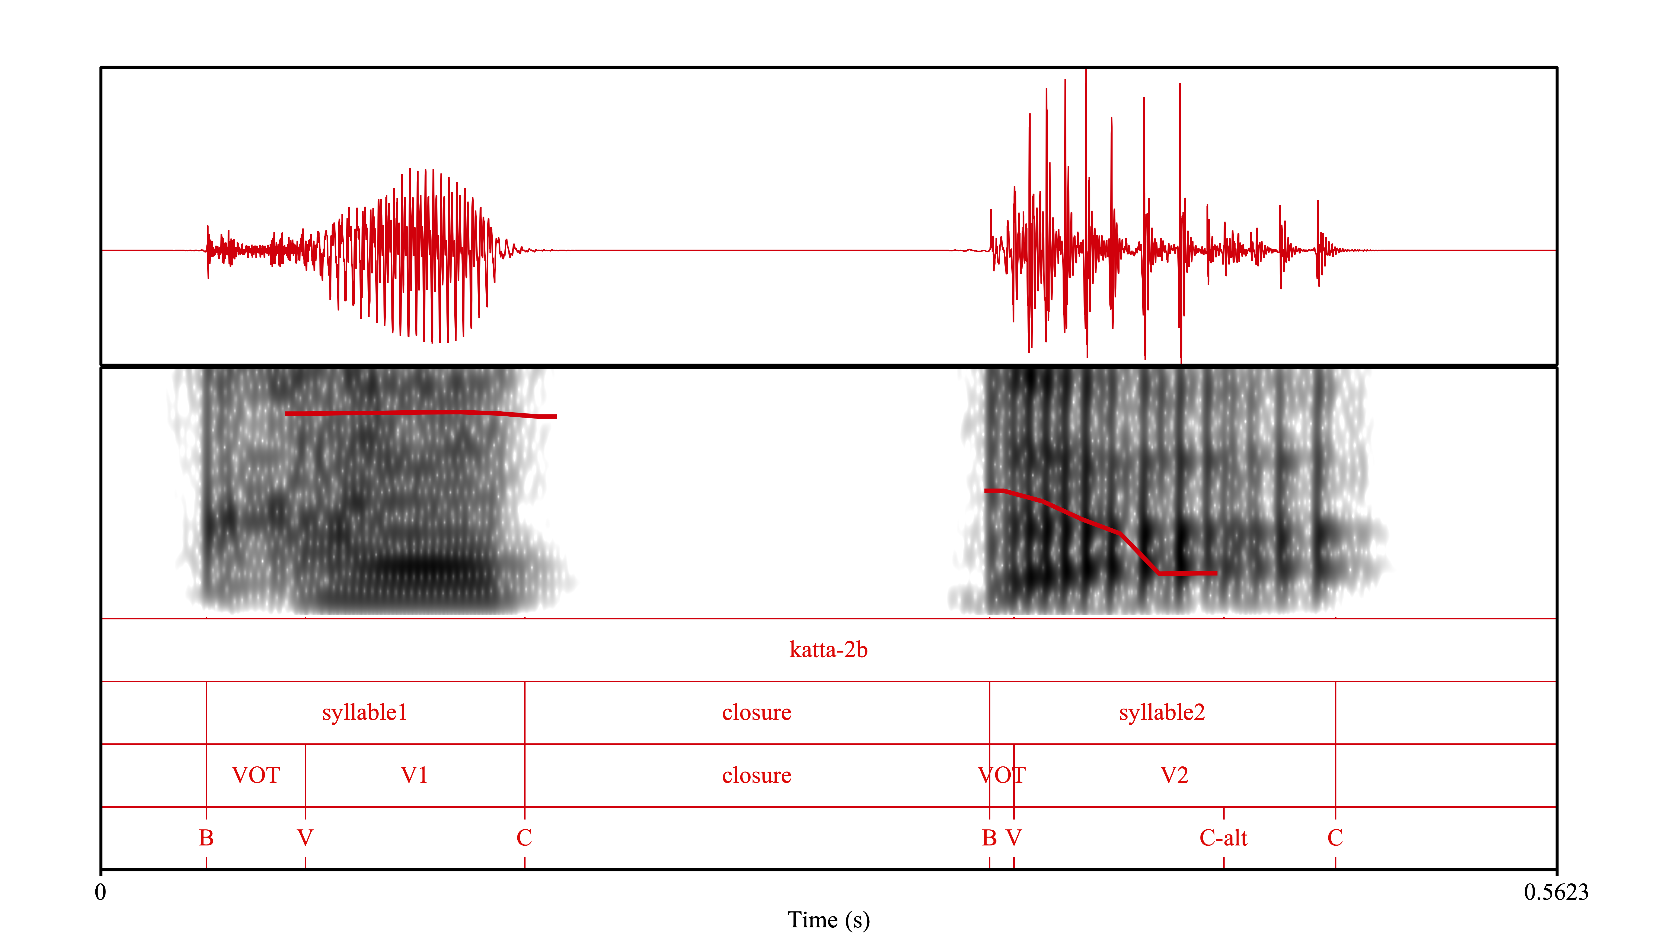
kata [t] vs. katta [tː]

Slide 25
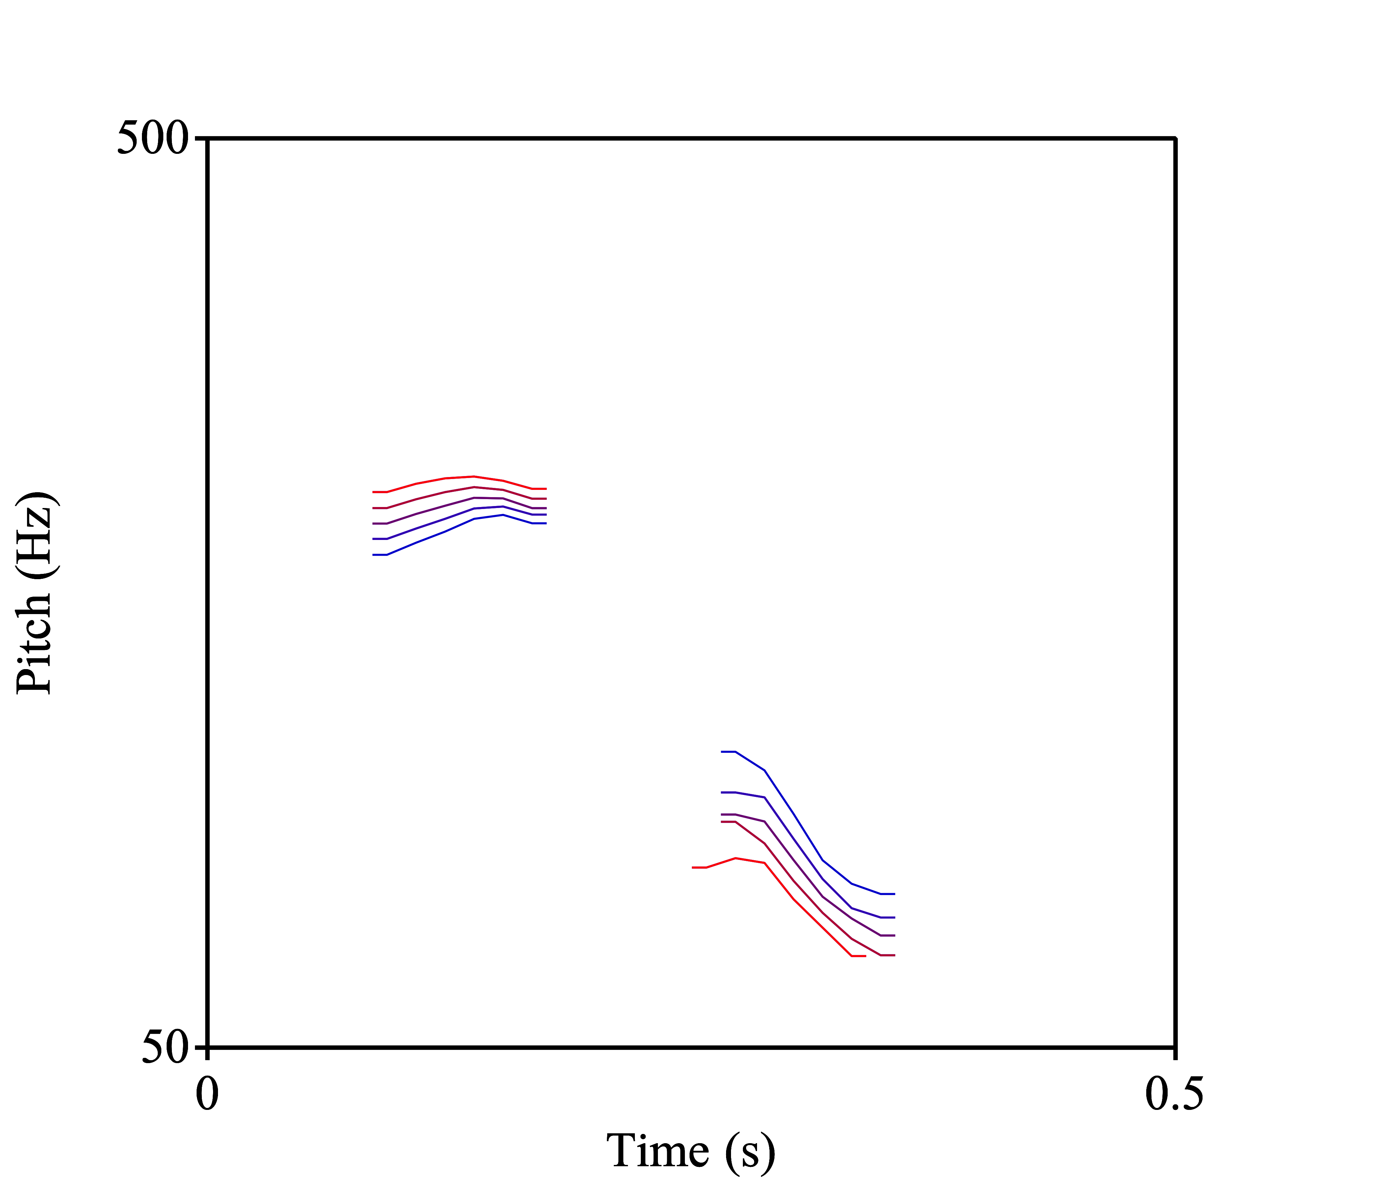
kata [t] vs. katta [tː]

Slide 26
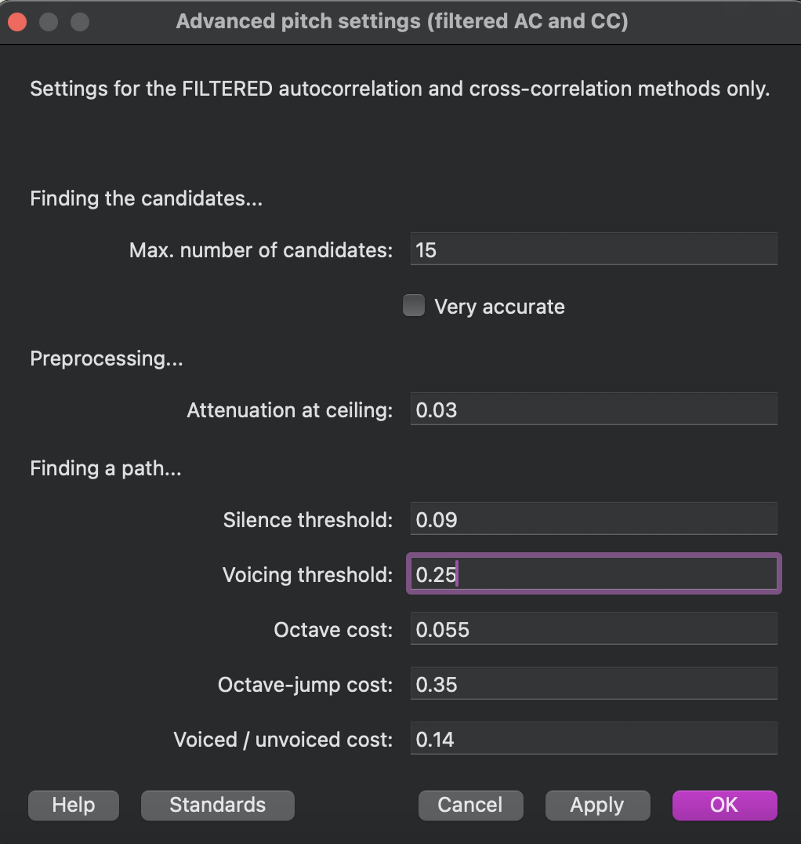
kata [t] vs. katta [tː]
Considerations:
script could only interpolate pitch with recordings that had matching time points
needed to interpolate pitch across both syllables
pitch tracking with creaky voice

Slide 27
kata [t] vs. katta [tː]
Steps:
1. manually line up each syllable separately by time
2. manually manipulate pitch objects to line up pitch tracking by time for each syllable
3. separately interpolate pitch between syllable 1 of both words and syllable 2 of both words (with silences appended for pitch tracking)
4. manually add missing pulse points for proper PSOLA
5. concatenate silence, syllable 1, closure, syllable 2, silence
Notes:
demonstrate script to show pitch object manipulation and manual adding of pulses and explain (can show pulses present in sound editor)
I first made each syllable roughly line up time wise as best as I could – I had originally tried to warp the duration of each syllable to be the mean duration between the two words but that resulted in weird pitch distortion, so I just tried to make the time marks of the syllables (and thus the start of voicing) roughly match up (I also adjusted this manually using the Pitch object (NOT the same as the PitchTier of the manipulation object) so that the voiced parts of the vowels lined up between the two words)
then, I interpolated pitch separately for each syllable (in log scale), starting from the kata endpoint and going to the Hz values of the katta endpoint, and then concatenated the syllables with the consonant closure from kata
this gave the five steps of the F0 drop cue, then for each of those five steps I created a duration continuum, just increasing the closure duration to the value for the katta endpoint (since each pitch step was starting with the duration from the katta step)
I did not make a second continuum with katta as the origin sound because the creaky voice makes it too poor of a starting point for manipulation
I also had to manually add pulse points to the manipulation object for the syllable 2 sounds because the Manipulation object is created only using raw auto-correlation periodicity tracking algorithm, which was not recognizing the F0 contour/pulses due to creaky voice (the F0 and pulse points of which were tracked fine using filtered auto-correlation) – it was only after manually adding the pulse points, then the add-overlap synthesis worked to perceptually change the pitch contour with the updated PitchTier from the interpolation

Slide 28
toru [o] vs. tooru [oː]
Primary: Vowel duration
toru | 1 (104 ms ) | 2 (142ms) | 3 (179 ms) | 4 (216 ms) | 5 (254 ms) | 6 (292 ms) | 7 (329 ms )
1 (toru-like – HL – modest pitch drop)
2
3
4
5 (tooru-like – HLL – more pronounced pitch drop) |  |  |  |  |  |  | tooru
Secondary: Pitch contour

Slide 29
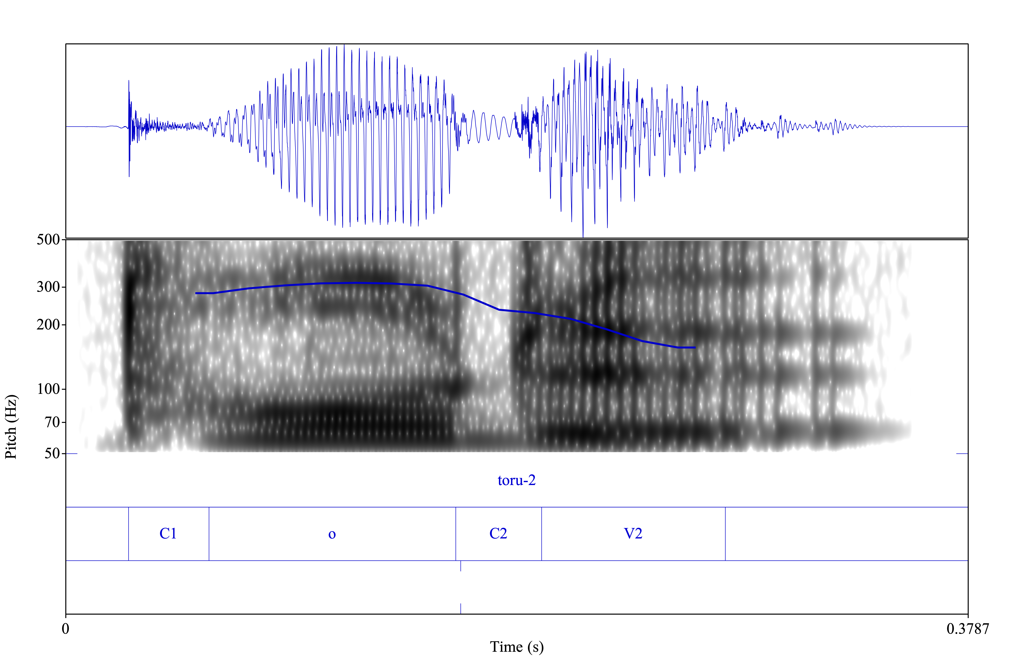
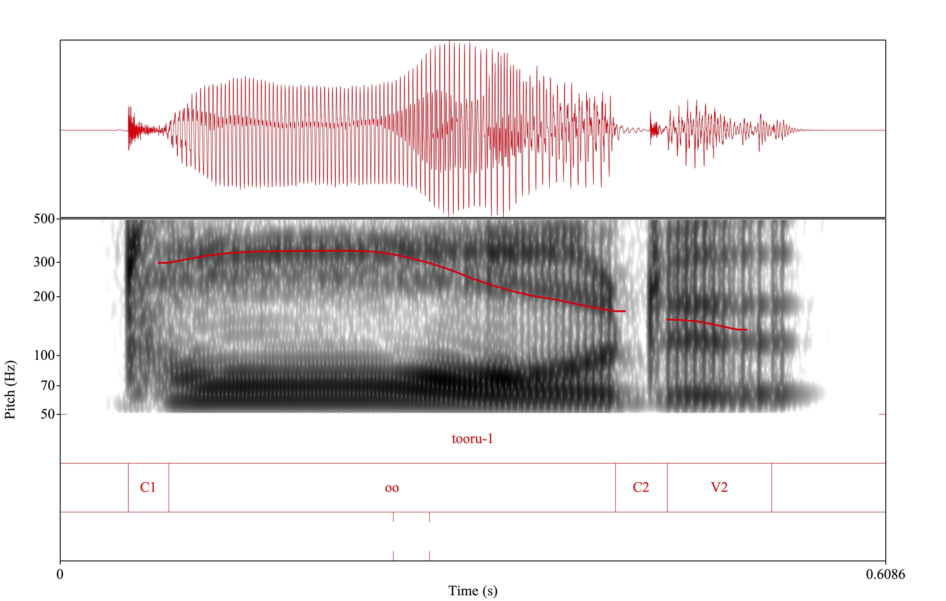
toru [o] vs. tooru [oː]
Notes:
show original and modified sounds
explain the 2.4x thing about natural sounding tokens
Notes:
the exact wav files used in this manipulation were toru_2_mod.wav and tooru_1_mod.wav – within Praat, I renamed them toru and tooru to make the naming process of the continua files easier
first I will make two equivalent duration continua, one that starts from each endpoint (of JUST the vowel length – C1, C2, and V2 duration will remain constant)
then I will interpolate pitch between the endpoints of equivalent duration (this includes pitch across V1 and V2)
because of the creaks at the end of the word (at the end of V2), I chose to edit out the last of the creaky voice where the regularity of the periodicity breaks down, and then replace it with 50ms of silence (specifically I concatenated with overlap, with the overlap being 1 ms (0.001 s)
I did this for both toru and tooru, and both are now called toru_2_mod.wav and tooru_1_mod.wav respectively – this works better for the pulse tracking on the manipulation object for the pitch and duration manipulations
I also had to adjust the silence at the beginning so that the start of the two words would be aligned and thus each of the duration manipulated steps (made from each starting point – continuum steps made from toru and continuum steps made from tooru) would also be aligned in order to properly do the pitch manipulation
tooru_1_mod.wav had 0.050226757369614516 s before the start of the word
toru_2_mod.wav had 0.026341107871720115 s before the start of the word
so I added 0.02388564949 s to the start of toru_2_mod.wav and the corresponding text grid (new text grid is saved as toru_2_mod.TextGrid)
I made two versions of all 35 tokens (7 dur x 5 F0), since the duration and F0 manipulations done on Praat can only be done using one word as the origin word and then interpolate to the values of the other word – i.e., manipulations are only being done using one sound file as the origin, not a merge between the two
first I made two duration continua, one that is toru_origin and one that is tooru_origin
then I will make two different F0 continua from each of these that interpolate the F0 contours between the equivalent duration steps of the toru_origin and tooru_origin continua
ver 1: toru_dur origin and toru_f0 origin
ver 2: tooru_dur origin and tooru_f0 origin
then I will make a matrix of the final 35 stimuli that will be used that attempts to equally use stimuli between the two versions
very important note: the F0 continua at dur_1 and dur_7 are derived from the base files toru_2_mod.wav and tooru_1_mod.wav respectively, rather than the endpoints that were created from making the duration continuum
the F0 continua at dur_2, dur_3, and dur_4 were derived from the toru_origin duration continuum sounds
the F0 continua at dur_4, dur_5, and dur_6 were derived from the tooru_origin duration continuum sounds
so there are two versions of F0 continua at dur_4 step
I will choose whether the sounds of the F0 continuum at dur_4 will be from the toru_origin or tooru_origin version
for dur_4, I will probably use toru_origin for F0_1, F0_2, and maybe F0_3, and then tooru_origin for F0_4 and F0_5, and maybe F0_3
***final choices, from my own ear: I will use toru_origin for dur_4_F0_1, and tooru_origin for the rest of dur_4 series (F0_2, F0_3, F0_4, F0_5) – these just sounded more natural from tooru_origin, while only F0_1 sounded more natural from toru_origin (only slightly)

Slide 30
toru [o] vs. tooru [oː]
Considerations:
pitch manipulation across different durations – need to normalize duration
manipulating durations to normalize affects pitch
pitch tracking with creaky voice
Notes:
show original and modified sounds
explain the 2.4x thing about natural sounding tokens
Notes:
the exact wav files used in this manipulation were toru_2_mod.wav and tooru_1_mod.wav – within Praat, I renamed them toru and tooru to make the naming process of the continua files easier
first I will make two equivalent duration continua, one that starts from each endpoint (of JUST the vowel length – C1, C2, and V2 duration will remain constant)
then I will interpolate pitch between the endpoints of equivalent duration (this includes pitch across V1 and V2)
because of the creaks at the end of the word (at the end of V2), I chose to edit out the last of the creaky voice where the regularity of the periodicity breaks down, and then replace it with 50ms of silence (specifically I concatenated with overlap, with the overlap being 1 ms (0.001 s)
I did this for both toru and tooru, and both are now called toru_2_mod.wav and tooru_1_mod.wav respectively – this works better for the pulse tracking on the manipulation object for the pitch and duration manipulations
I also had to adjust the silence at the beginning so that the start of the two words would be aligned and thus each of the duration manipulated steps (made from each starting point – continuum steps made from toru and continuum steps made from tooru) would also be aligned in order to properly do the pitch manipulation
tooru_1_mod.wav had 0.050226757369614516 s before the start of the word
toru_2_mod.wav had 0.026341107871720115 s before the start of the word
so I added 0.02388564949 s to the start of toru_2_mod.wav and the corresponding text grid (new text grid is saved as toru_2_mod.TextGrid)
I made two versions of all 35 tokens (7 dur x 5 F0), since the duration and F0 manipulations done on Praat can only be done using one word as the origin word and then interpolate to the values of the other word – i.e., manipulations are only being done using one sound file as the origin, not a merge between the two
first I made two duration continua, one that is toru_origin and one that is tooru_origin
then I will make two different F0 continua from each of these that interpolate the F0 contours between the equivalent duration steps of the toru_origin and tooru_origin continua
ver 1: toru_dur origin and toru_f0 origin
ver 2: tooru_dur origin and tooru_f0 origin
then I will make a matrix of the final 35 stimuli that will be used that attempts to equally use stimuli between the two versions
very important note: the F0 continua at dur_1 and dur_7 are derived from the base files toru_2_mod.wav and tooru_1_mod.wav respectively, rather than the endpoints that were created from making the duration continuum
the F0 continua at dur_2, dur_3, and dur_4 were derived from the toru_origin duration continuum sounds
the F0 continua at dur_4, dur_5, and dur_6 were derived from the tooru_origin duration continuum sounds
so there are two versions of F0 continua at dur_4 step
I will choose whether the sounds of the F0 continuum at dur_4 will be from the toru_origin or tooru_origin version
for dur_4, I will probably use toru_origin for F0_1, F0_2, and maybe F0_3, and then tooru_origin for F0_4 and F0_5, and maybe F0_3
***final choices, from my own ear: I will use toru_origin for dur_4_F0_1, and tooru_origin for the rest of dur_4 series (F0_2, F0_3, F0_4, F0_5) – these just sounded more natural from tooru_origin, while only F0_1 sounded more natural from toru_origin (only slightly)

Slide 31
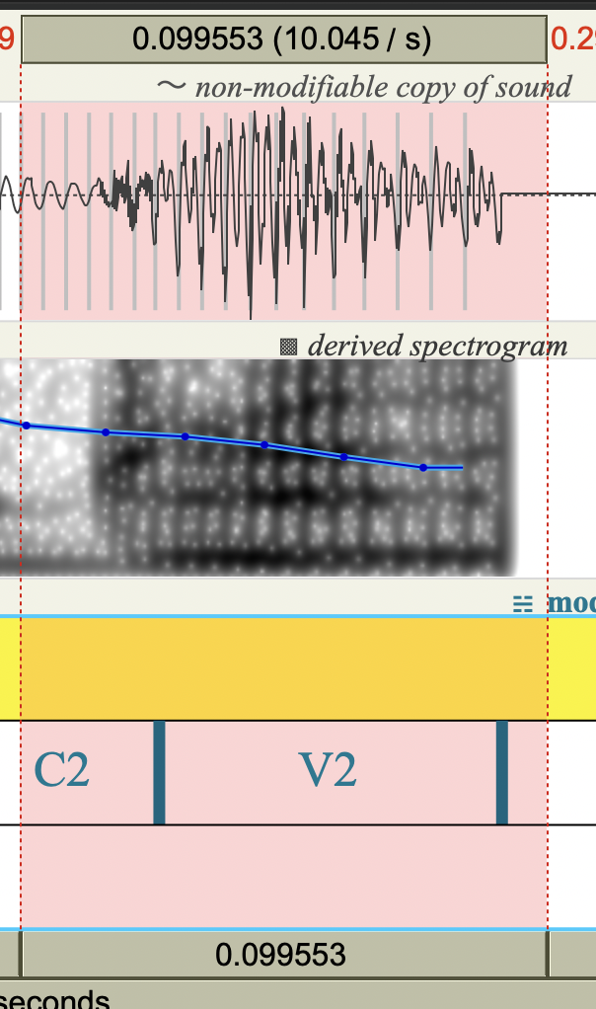
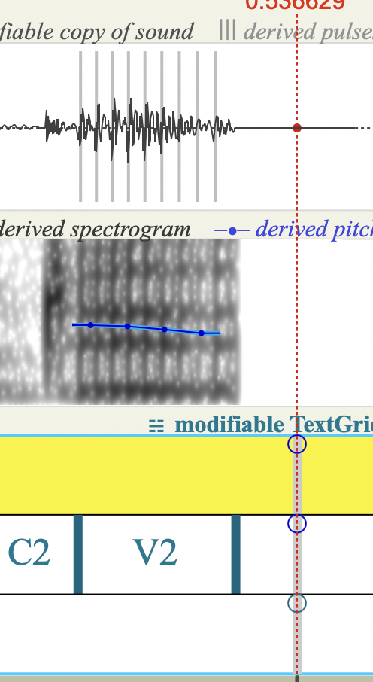
toru [o] vs. tooru [oː]
Considerations:
pitch tracking with creaky voice
“-ru” from toru
“-ru” from tooru
Notes:
show original and modified sounds
explain the 2.4x thing about natural sounding tokens
Notes:
the exact wav files used in this manipulation were toru_2_mod.wav and tooru_1_mod.wav – within Praat, I renamed them toru and tooru to make the naming process of the continua files easier
first I will make two equivalent duration continua, one that starts from each endpoint (of JUST the vowel length – C1, C2, and V2 duration will remain constant)
then I will interpolate pitch between the endpoints of equivalent duration (this includes pitch across V1 and V2)
because of the creaks at the end of the word (at the end of V2), I chose to edit out the last of the creaky voice where the regularity of the periodicity breaks down, and then replace it with 50ms of silence (specifically I concatenated with overlap, with the overlap being 1 ms (0.001 s)
I did this for both toru and tooru, and both are now called toru_2_mod.wav and tooru_1_mod.wav respectively – this works better for the pulse tracking on the manipulation object for the pitch and duration manipulations
I also had to adjust the silence at the beginning so that the start of the two words would be aligned and thus each of the duration manipulated steps (made from each starting point – continuum steps made from toru and continuum steps made from tooru) would also be aligned in order to properly do the pitch manipulation
tooru_1_mod.wav had 0.050226757369614516 s before the start of the word
toru_2_mod.wav had 0.026341107871720115 s before the start of the word
so I added 0.02388564949 s to the start of toru_2_mod.wav and the corresponding text grid (new text grid is saved as toru_2_mod.TextGrid)
I made two versions of all 35 tokens (7 dur x 5 F0), since the duration and F0 manipulations done on Praat can only be done using one word as the origin word and then interpolate to the values of the other word – i.e., manipulations are only being done using one sound file as the origin, not a merge between the two
first I made two duration continua, one that is toru_origin and one that is tooru_origin
then I will make two different F0 continua from each of these that interpolate the F0 contours between the equivalent duration steps of the toru_origin and tooru_origin continua
ver 1: toru_dur origin and toru_f0 origin
ver 2: tooru_dur origin and tooru_f0 origin
then I will make a matrix of the final 35 stimuli that will be used that attempts to equally use stimuli between the two versions
very important note: the F0 continua at dur_1 and dur_7 are derived from the base files toru_2_mod.wav and tooru_1_mod.wav respectively, rather than the endpoints that were created from making the duration continuum
the F0 continua at dur_2, dur_3, and dur_4 were derived from the toru_origin duration continuum sounds
the F0 continua at dur_4, dur_5, and dur_6 were derived from the tooru_origin duration continuum sounds
so there are two versions of F0 continua at dur_4 step
I will choose whether the sounds of the F0 continuum at dur_4 will be from the toru_origin or tooru_origin version
for dur_4, I will probably use toru_origin for F0_1, F0_2, and maybe F0_3, and then tooru_origin for F0_4 and F0_5, and maybe F0_3
***final choices, from my own ear: I will use toru_origin for dur_4_F0_1, and tooru_origin for the rest of dur_4 series (F0_2, F0_3, F0_4, F0_5) – these just sounded more natural from tooru_origin, while only F0_1 sounded more natural from toru_origin (only slightly)

Slide 32
toru [o] vs. tooru [oː]
Considerations:
pitch manipulation across different durations – need to normalize duration
manipulating durations to normalize affects pitch
pitch tracking with creaky voice
changing duration by more than 2.4x makes stimuli sound more synthetic
Notes:
show original and modified sounds
explain the 2.4x thing about natural sounding tokens
Notes:
the exact wav files used in this manipulation were toru_2_mod.wav and tooru_1_mod.wav – within Praat, I renamed them toru and tooru to make the naming process of the continua files easier
first I will make two equivalent duration continua, one that starts from each endpoint (of JUST the vowel length – C1, C2, and V2 duration will remain constant)
then I will interpolate pitch between the endpoints of equivalent duration (this includes pitch across V1 and V2)
because of the creaks at the end of the word (at the end of V2), I chose to edit out the last of the creaky voice where the regularity of the periodicity breaks down, and then replace it with 50ms of silence (specifically I concatenated with overlap, with the overlap being 1 ms (0.001 s)
I did this for both toru and tooru, and both are now called toru_2_mod.wav and tooru_1_mod.wav respectively – this works better for the pulse tracking on the manipulation object for the pitch and duration manipulations
I also had to adjust the silence at the beginning so that the start of the two words would be aligned and thus each of the duration manipulated steps (made from each starting point – continuum steps made from toru and continuum steps made from tooru) would also be aligned in order to properly do the pitch manipulation
tooru_1_mod.wav had 0.050226757369614516 s before the start of the word
toru_2_mod.wav had 0.026341107871720115 s before the start of the word
so I added 0.02388564949 s to the start of toru_2_mod.wav and the corresponding text grid (new text grid is saved as toru_2_mod.TextGrid)
I made two versions of all 35 tokens (7 dur x 5 F0), since the duration and F0 manipulations done on Praat can only be done using one word as the origin word and then interpolate to the values of the other word – i.e., manipulations are only being done using one sound file as the origin, not a merge between the two
first I made two duration continua, one that is toru_origin and one that is tooru_origin
then I will make two different F0 continua from each of these that interpolate the F0 contours between the equivalent duration steps of the toru_origin and tooru_origin continua
ver 1: toru_dur origin and toru_f0 origin
ver 2: tooru_dur origin and tooru_f0 origin
then I will make a matrix of the final 35 stimuli that will be used that attempts to equally use stimuli between the two versions
very important note: the F0 continua at dur_1 and dur_7 are derived from the base files toru_2_mod.wav and tooru_1_mod.wav respectively, rather than the endpoints that were created from making the duration continuum
the F0 continua at dur_2, dur_3, and dur_4 were derived from the toru_origin duration continuum sounds
the F0 continua at dur_4, dur_5, and dur_6 were derived from the tooru_origin duration continuum sounds
so there are two versions of F0 continua at dur_4 step
I will choose whether the sounds of the F0 continuum at dur_4 will be from the toru_origin or tooru_origin version
for dur_4, I will probably use toru_origin for F0_1, F0_2, and maybe F0_3, and then tooru_origin for F0_4 and F0_5, and maybe F0_3
***final choices, from my own ear: I will use toru_origin for dur_4_F0_1, and tooru_origin for the rest of dur_4 series (F0_2, F0_3, F0_4, F0_5) – these just sounded more natural from tooru_origin, while only F0_1 sounded more natural from toru_origin (only slightly)

Slide 33
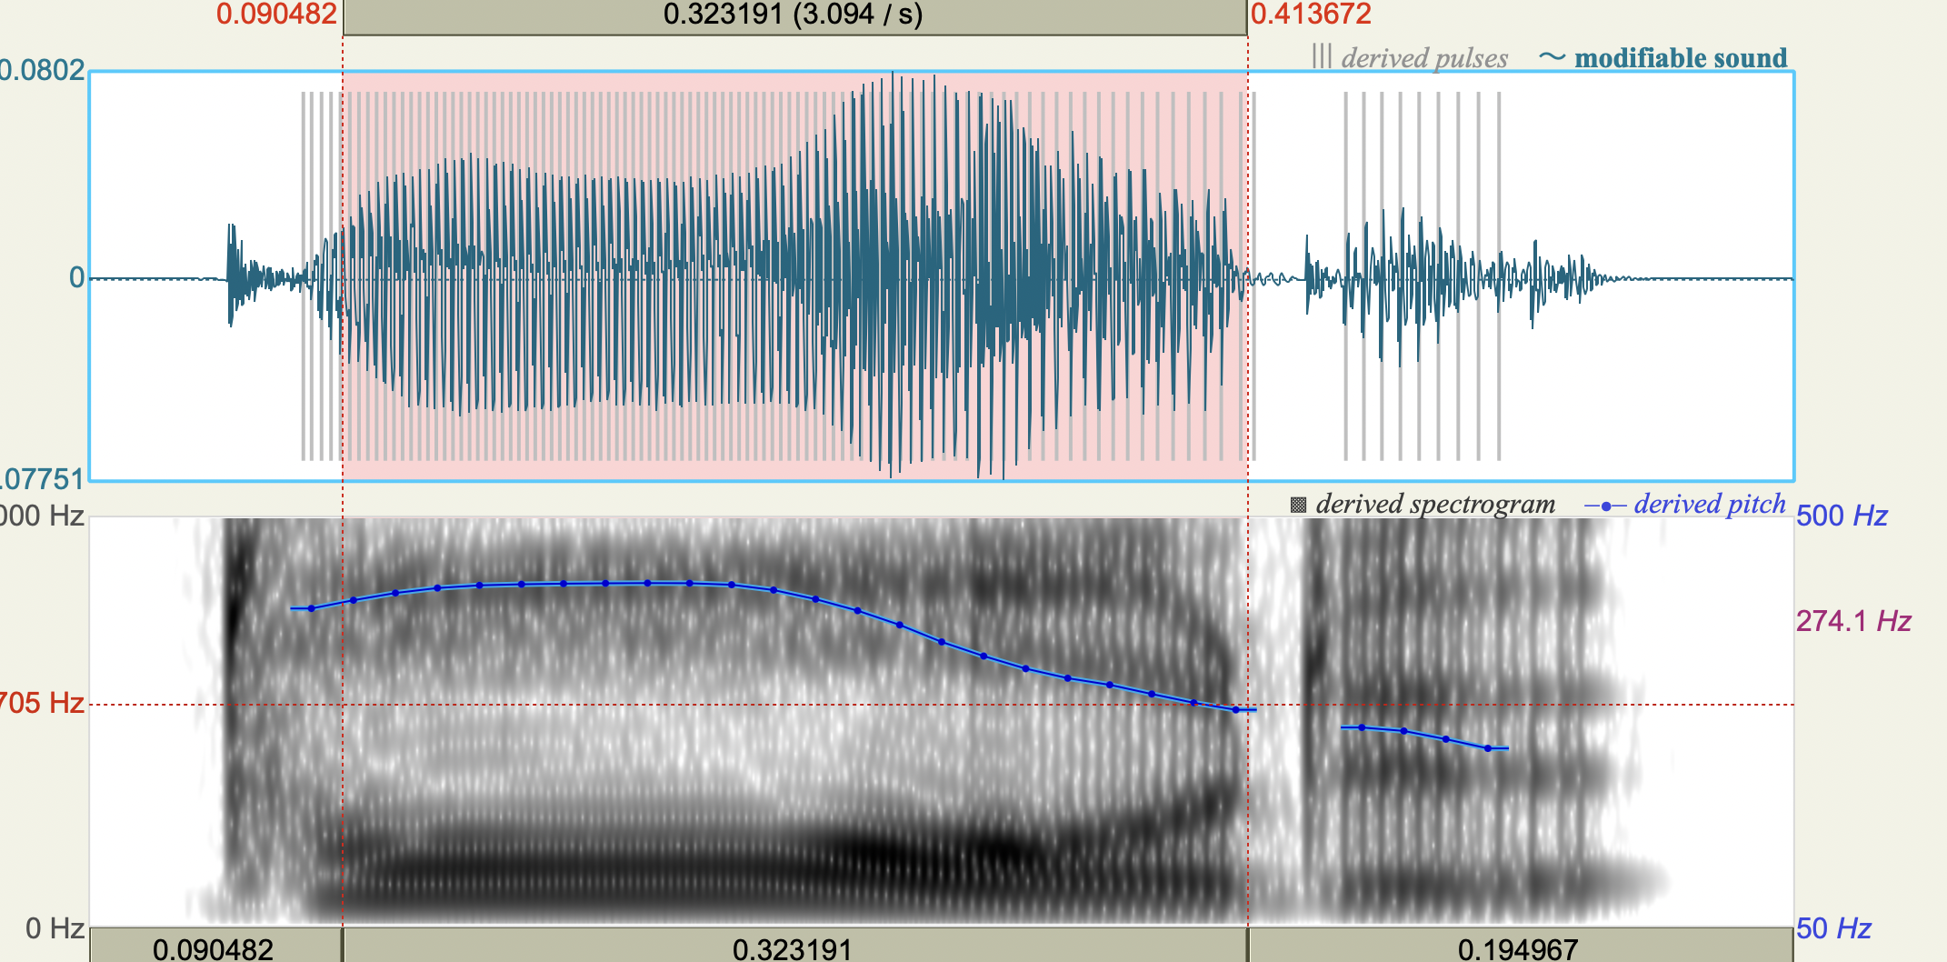
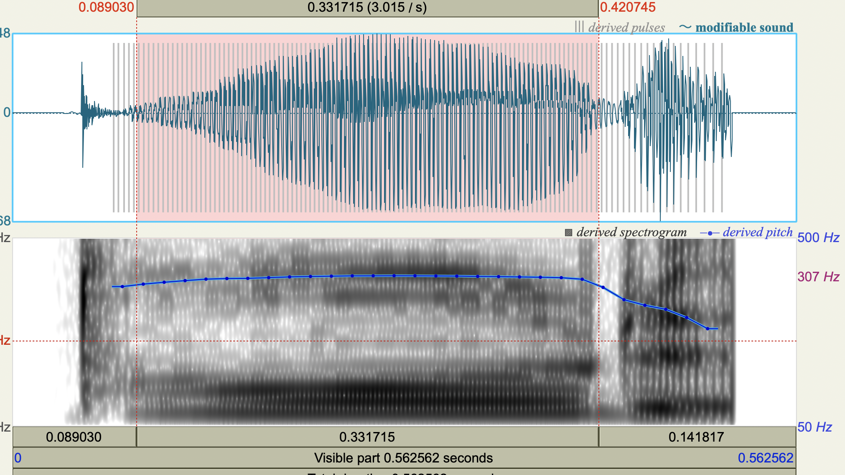
toru [o] vs. tooru [oː]
Considerations:
changing duration by more than 2.4x makes stimuli sound more synthetic
original “tooru”
“tooru”-duration from “toru” origin
Notes:
show original and modified sounds
explain the 2.4x thing about natural sounding tokens
Notes:
the exact wav files used in this manipulation were toru_2_mod.wav and tooru_1_mod.wav – within Praat, I renamed them toru and tooru to make the naming process of the continua files easier
first I will make two equivalent duration continua, one that starts from each endpoint (of JUST the vowel length – C1, C2, and V2 duration will remain constant)
then I will interpolate pitch between the endpoints of equivalent duration (this includes pitch across V1 and V2)
because of the creaks at the end of the word (at the end of V2), I chose to edit out the last of the creaky voice where the regularity of the periodicity breaks down, and then replace it with 50ms of silence (specifically I concatenated with overlap, with the overlap being 1 ms (0.001 s)
I did this for both toru and tooru, and both are now called toru_2_mod.wav and tooru_1_mod.wav respectively – this works better for the pulse tracking on the manipulation object for the pitch and duration manipulations
I also had to adjust the silence at the beginning so that the start of the two words would be aligned and thus each of the duration manipulated steps (made from each starting point – continuum steps made from toru and continuum steps made from tooru) would also be aligned in order to properly do the pitch manipulation
tooru_1_mod.wav had 0.050226757369614516 s before the start of the word
toru_2_mod.wav had 0.026341107871720115 s before the start of the word
so I added 0.02388564949 s to the start of toru_2_mod.wav and the corresponding text grid (new text grid is saved as toru_2_mod.TextGrid)
I made two versions of all 35 tokens (7 dur x 5 F0), since the duration and F0 manipulations done on Praat can only be done using one word as the origin word and then interpolate to the values of the other word – i.e., manipulations are only being done using one sound file as the origin, not a merge between the two
first I made two duration continua, one that is toru_origin and one that is tooru_origin
then I will make two different F0 continua from each of these that interpolate the F0 contours between the equivalent duration steps of the toru_origin and tooru_origin continua
ver 1: toru_dur origin and toru_f0 origin
ver 2: tooru_dur origin and tooru_f0 origin
then I will make a matrix of the final 35 stimuli that will be used that attempts to equally use stimuli between the two versions
very important note: the F0 continua at dur_1 and dur_7 are derived from the base files toru_2_mod.wav and tooru_1_mod.wav respectively, rather than the endpoints that were created from making the duration continuum
the F0 continua at dur_2, dur_3, and dur_4 were derived from the toru_origin duration continuum sounds
the F0 continua at dur_4, dur_5, and dur_6 were derived from the tooru_origin duration continuum sounds
so there are two versions of F0 continua at dur_4 step
I will choose whether the sounds of the F0 continuum at dur_4 will be from the toru_origin or tooru_origin version
for dur_4, I will probably use toru_origin for F0_1, F0_2, and maybe F0_3, and then tooru_origin for F0_4 and F0_5, and maybe F0_3
***final choices, from my own ear: I will use toru_origin for dur_4_F0_1, and tooru_origin for the rest of dur_4 series (F0_2, F0_3, F0_4, F0_5) – these just sounded more natural from tooru_origin, while only F0_1 sounded more natural from toru_origin (only slightly)

Slide 34
toru [o] vs. tooru [oː]
Process
manipulate ends of each word to cut off creaky voice (that was a choice...)
make duration continuum starting from each endpoint (toru-origin and tooru-origin) to make duration manipulation less than 2.4x
interpolate pitch between each corresponding step of duration continuums (e.g., interpolate between toru_origin_dur_1 and tooru_origin_dur_1, etc.)
the base word for f0 interpolations was toru for low dur steps (1-4) and tooru for high dur steps (4-7) – for dur_4 steps, I picked the most natural sounding tokens between toru_origin and tooru_origin
Notes:
demonstrate script?? maybe not necessary
Notes:
the exact wav files used in this manipulation were toru_2_mod.wav and tooru_1_mod.wav – within Praat, I renamed them toru and tooru to make the naming process of the continua files easier
first I will make two equivalent duration continua, one that starts from each endpoint (of JUST the vowel length – C1, C2, and V2 duration will remain constant)
then I will interpolate pitch between the endpoints of equivalent duration (this includes pitch across V1 and V2)
because of the creaks at the end of the word (at the end of V2), I chose to edit out the last of the creaky voice where the regularity of the periodicity breaks down, and then replace it with 50ms of silence (specifically I concatenated with overlap, with the overlap being 1 ms (0.001 s)
I did this for both toru and tooru, and both are now called toru_2_mod.wav and tooru_1_mod.wav respectively – this works better for the pulse tracking on the manipulation object for the pitch and duration manipulations
I also had to adjust the silence at the beginning so that the start of the two words would be aligned and thus each of the duration manipulated steps (made from each starting point – continuum steps made from toru and continuum steps made from tooru) would also be aligned in order to properly do the pitch manipulation
tooru_1_mod.wav had 0.050226757369614516 s before the start of the word
toru_2_mod.wav had 0.026341107871720115 s before the start of the word
so I added 0.02388564949 s to the start of toru_2_mod.wav and the corresponding text grid (new text grid is saved as toru_2_mod.TextGrid)
I made two versions of all 35 tokens (7 dur x 5 F0), since the duration and F0 manipulations done on Praat can only be done using one word as the origin word and then interpolate to the values of the other word – i.e., manipulations are only being done using one sound file as the origin, not a merge between the two
first I made two duration continua, one that is toru_origin and one that is tooru_origin
then I will make two different F0 continua from each of these that interpolate the F0 contours between the equivalent duration steps of the toru_origin and tooru_origin continua
ver 1: toru_dur origin and toru_f0 origin
ver 2: tooru_dur origin and tooru_f0 origin
then I will make a matrix of the final 35 stimuli that will be used that attempts to equally use stimuli between the two versions
very important note: the F0 continua at dur_1 and dur_7 are derived from the base files toru_2_mod.wav and tooru_1_mod.wav respectively, rather than the endpoints that were created from making the duration continuum
the F0 continua at dur_2, dur_3, and dur_4 were derived from the toru_origin duration continuum sounds
the F0 continua at dur_4, dur_5, and dur_6 were derived from the tooru_origin duration continuum sounds
so there are two versions of F0 continua at dur_4 step
I will choose whether the sounds of the F0 continuum at dur_4 will be from the toru_origin or tooru_origin version
for dur_4, I will probably use toru_origin for F0_1, F0_2, and maybe F0_3, and then tooru_origin for F0_4 and F0_5, and maybe F0_3
***final choices, from my own ear: I will use toru_origin for dur_4_F0_1, and tooru_origin for the rest of dur_4 series (F0_2, F0_3, F0_4, F0_5) – these just sounded more natural from tooru_origin, while only F0_1 sounded more natural from toru_origin (only slightly)

Slide 35
toru [o] as base word vs. tooru [oː] as base word
Process, visualized
Primary: Vowel duration
1 (104 ms )
2 (142 ms)
3 (179 ms)
4 (216 ms)
5 (254 ms)
6 (292 ms)
7 (329 ms )
toru-origin
tooru-origin
Notes:
demonstrate script?? maybe not necessary
Notes:
the exact wav files used in this manipulation were toru_2_mod.wav and tooru_1_mod.wav – within Praat, I renamed them toru and tooru to make the naming process of the continua files easier
first I will make two equivalent duration continua, one that starts from each endpoint (of JUST the vowel length – C1, C2, and V2 duration will remain constant)
then I will interpolate pitch between the endpoints of equivalent duration (this includes pitch across V1 and V2)
because of the creaks at the end of the word (at the end of V2), I chose to edit out the last of the creaky voice where the regularity of the periodicity breaks down, and then replace it with 50ms of silence (specifically I concatenated with overlap, with the overlap being 1 ms (0.001 s)
I did this for both toru and tooru, and both are now called toru_2_mod.wav and tooru_1_mod.wav respectively – this works better for the pulse tracking on the manipulation object for the pitch and duration manipulations
I also had to adjust the silence at the beginning so that the start of the two words would be aligned and thus each of the duration manipulated steps (made from each starting point – continuum steps made from toru and continuum steps made from tooru) would also be aligned in order to properly do the pitch manipulation
tooru_1_mod.wav had 0.050226757369614516 s before the start of the word
toru_2_mod.wav had 0.026341107871720115 s before the start of the word
so I added 0.02388564949 s to the start of toru_2_mod.wav and the corresponding text grid (new text grid is saved as toru_2_mod.TextGrid)
I made two versions of all 35 tokens (7 dur x 5 F0), since the duration and F0 manipulations done on Praat can only be done using one word as the origin word and then interpolate to the values of the other word – i.e., manipulations are only being done using one sound file as the origin, not a merge between the two
first I made two duration continua, one that is toru_origin and one that is tooru_origin
then I will make two different F0 continua from each of these that interpolate the F0 contours between the equivalent duration steps of the toru_origin and tooru_origin continua
ver 1: toru_dur origin and toru_f0 origin
ver 2: tooru_dur origin and tooru_f0 origin
then I will make a matrix of the final 35 stimuli that will be used that attempts to equally use stimuli between the two versions
very important note: the F0 continua at dur_1 and dur_7 are derived from the base files toru_2_mod.wav and tooru_1_mod.wav respectively, rather than the endpoints that were created from making the duration continuum
the F0 continua at dur_2, dur_3, and dur_4 were derived from the toru_origin duration continuum sounds
the F0 continua at dur_4, dur_5, and dur_6 were derived from the tooru_origin duration continuum sounds
so there are two versions of F0 continua at dur_4 step
I will choose whether the sounds of the F0 continuum at dur_4 will be from the toru_origin or tooru_origin version
for dur_4, I will probably use toru_origin for F0_1, F0_2, and maybe F0_3, and then tooru_origin for F0_4 and F0_5, and maybe F0_3
***final choices, from my own ear: I will use toru_origin for dur_4_F0_1, and tooru_origin for the rest of dur_4 series (F0_2, F0_3, F0_4, F0_5) – these just sounded more natural from tooru_origin, while only F0_1 sounded more natural from toru_origin (only slightly)

Slide 36
toru [o] as base word vs. tooru [oː] as base word
Process, visualized
Primary: Vowel duration
 | 1 (104 ms ) | 2 | 3 | 4 | 5 | 6 | 7 (329 ms )
1 (toru-like - HL) | toru-origin
2
3
4
5 |  |  |  |  |  |  | tooru-origin
Secondary: Pitch contour
Notes:
demonstrate script?? maybe not necessary
Notes:
the exact wav files used in this manipulation were toru_2_mod.wav and tooru_1_mod.wav – within Praat, I renamed them toru and tooru to make the naming process of the continua files easier
first I will make two equivalent duration continua, one that starts from each endpoint (of JUST the vowel length – C1, C2, and V2 duration will remain constant)
then I will interpolate pitch between the endpoints of equivalent duration (this includes pitch across V1 and V2)
because of the creaks at the end of the word (at the end of V2), I chose to edit out the last of the creaky voice where the regularity of the periodicity breaks down, and then replace it with 50ms of silence (specifically I concatenated with overlap, with the overlap being 1 ms (0.001 s)
I did this for both toru and tooru, and both are now called toru_2_mod.wav and tooru_1_mod.wav respectively – this works better for the pulse tracking on the manipulation object for the pitch and duration manipulations
I also had to adjust the silence at the beginning so that the start of the two words would be aligned and thus each of the duration manipulated steps (made from each starting point – continuum steps made from toru and continuum steps made from tooru) would also be aligned in order to properly do the pitch manipulation
tooru_1_mod.wav had 0.050226757369614516 s before the start of the word
toru_2_mod.wav had 0.026341107871720115 s before the start of the word
so I added 0.02388564949 s to the start of toru_2_mod.wav and the corresponding text grid (new text grid is saved as toru_2_mod.TextGrid)
I made two versions of all 35 tokens (7 dur x 5 F0), since the duration and F0 manipulations done on Praat can only be done using one word as the origin word and then interpolate to the values of the other word – i.e., manipulations are only being done using one sound file as the origin, not a merge between the two
first I made two duration continua, one that is toru_origin and one that is tooru_origin
then I will make two different F0 continua from each of these that interpolate the F0 contours between the equivalent duration steps of the toru_origin and tooru_origin continua
ver 1: toru_dur origin and toru_f0 origin
ver 2: tooru_dur origin and tooru_f0 origin
then I will make a matrix of the final 35 stimuli that will be used that attempts to equally use stimuli between the two versions
very important note: the F0 continua at dur_1 and dur_7 are derived from the base files toru_2_mod.wav and tooru_1_mod.wav respectively, rather than the endpoints that were created from making the duration continuum
the F0 continua at dur_2, dur_3, and dur_4 were derived from the toru_origin duration continuum sounds
the F0 continua at dur_4, dur_5, and dur_6 were derived from the tooru_origin duration continuum sounds
so there are two versions of F0 continua at dur_4 step
I will choose whether the sounds of the F0 continuum at dur_4 will be from the toru_origin or tooru_origin version
for dur_4, I will probably use toru_origin for F0_1, F0_2, and maybe F0_3, and then tooru_origin for F0_4 and F0_5, and maybe F0_3
***final choices, from my own ear: I will use toru_origin for dur_4_F0_1, and tooru_origin for the rest of dur_4 series (F0_2, F0_3, F0_4, F0_5) – these just sounded more natural from tooru_origin, while only F0_1 sounded more natural from toru_origin (only slightly)

Slide 37
toru [o] as base word vs. tooru [oː] as base word
Primary: Vowel duration
 | 1 (104 ms ) | 2 | 3 | 4 | 5 | 6 | 7 (329 ms )
1 (toru-like – HL – modest pitch drop) | toru-origin
2
3
4
5 (tooru-like – HLL – more pronounced pitch drop) |  |  |  |  |  |  | tooru-origin
Secondary: Pitch contour

Slide 38
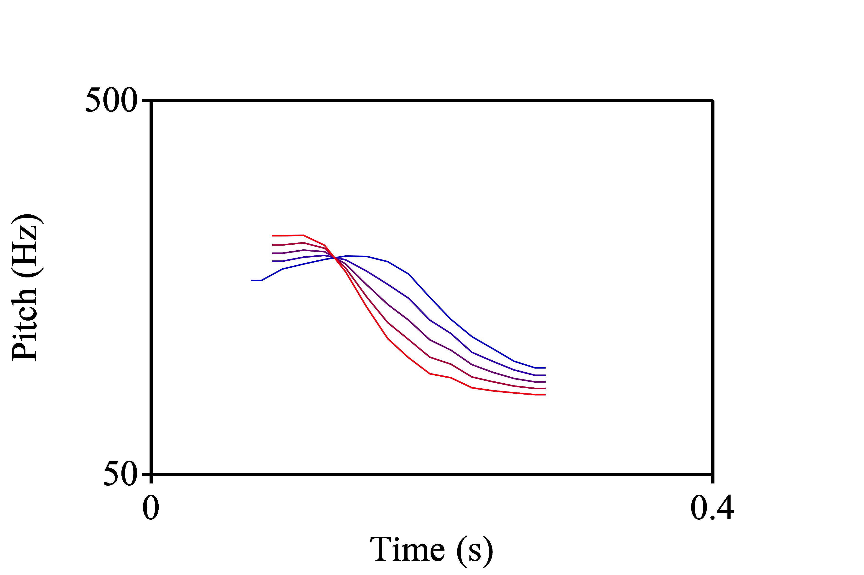
dur-1

Slide 39
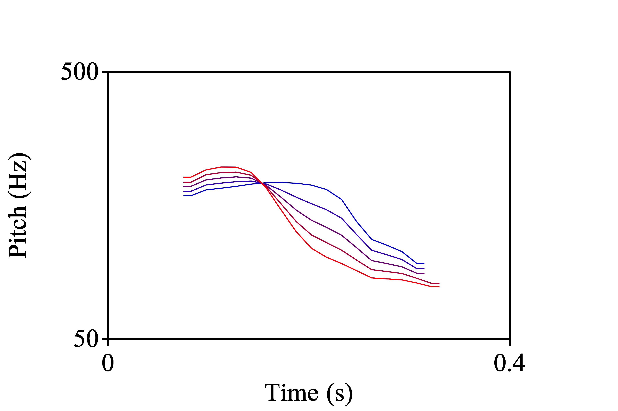
dur-2

Slide 40
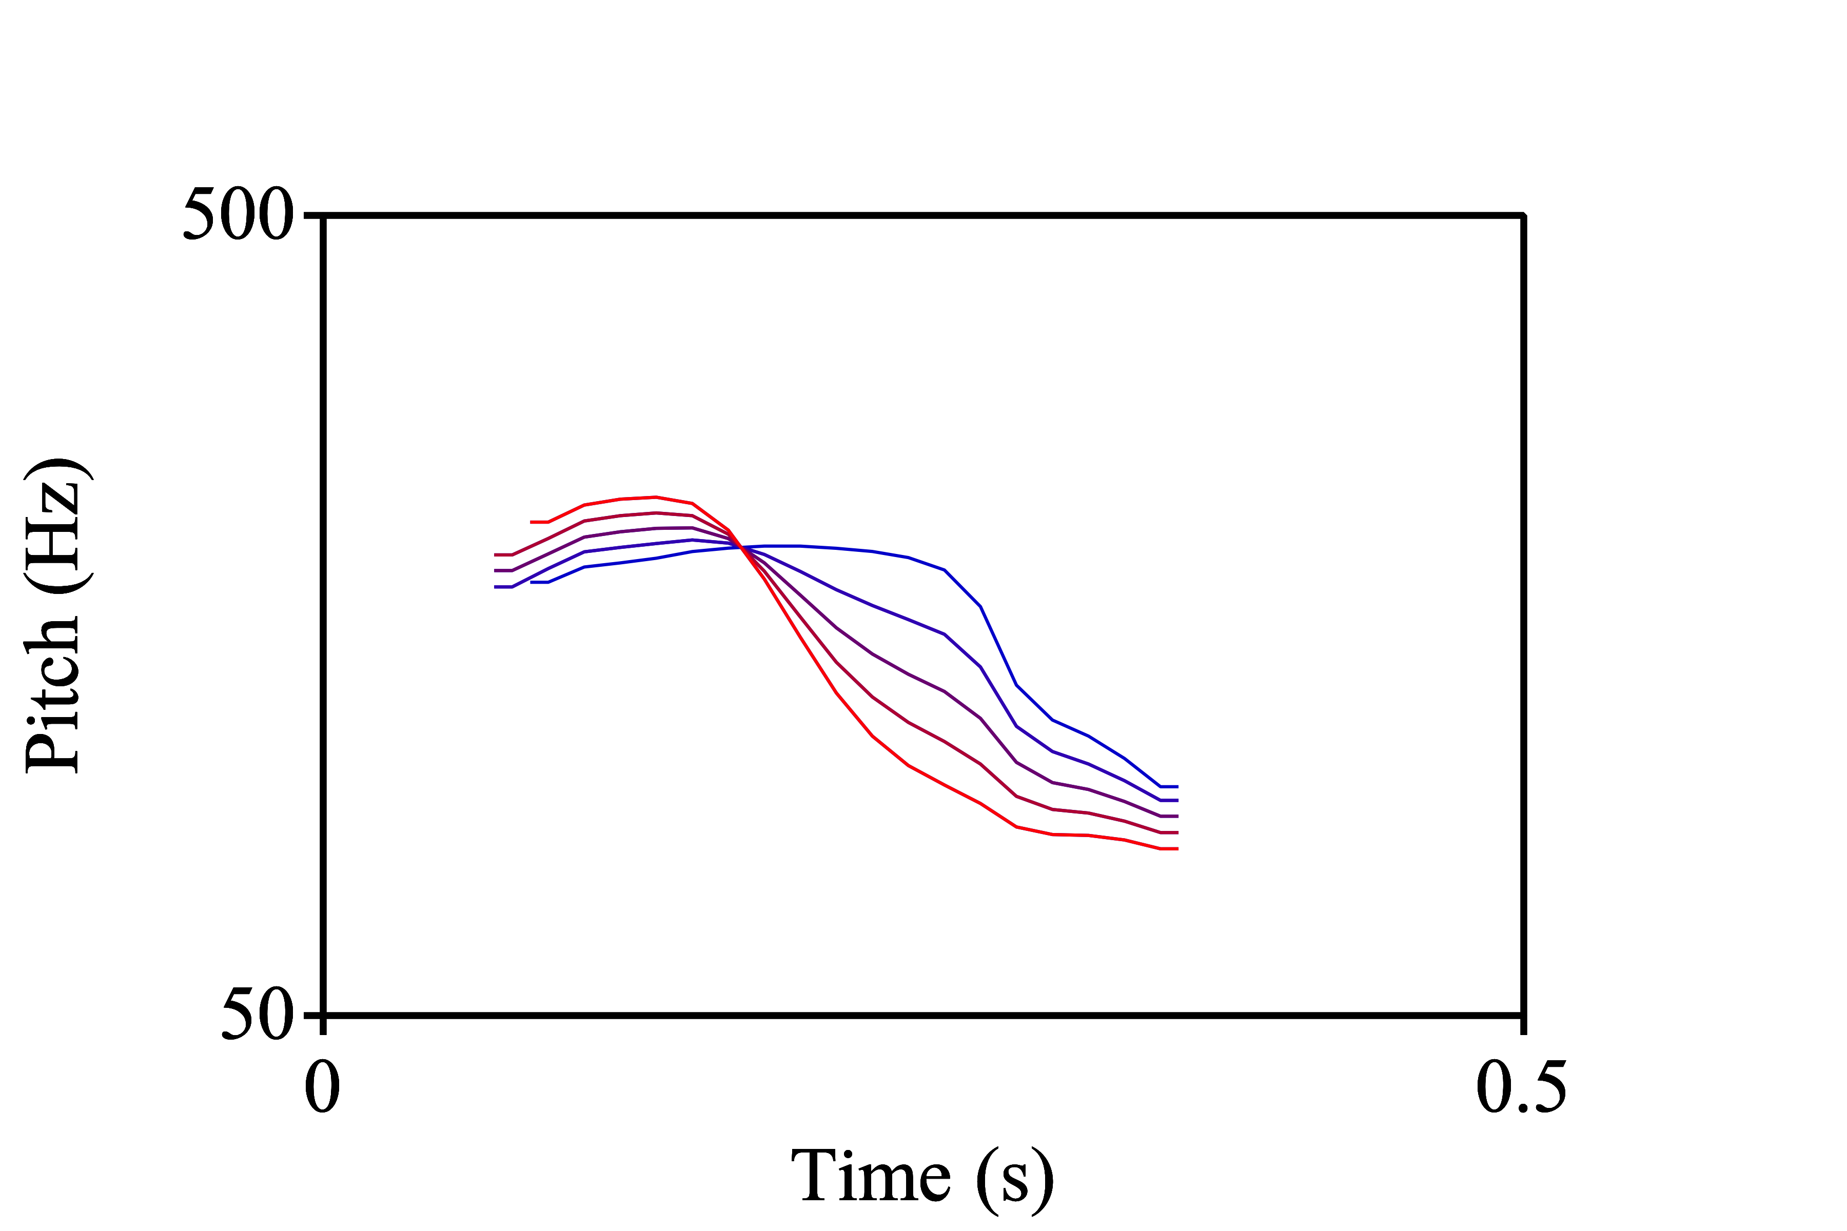
dur-3

Slide 41
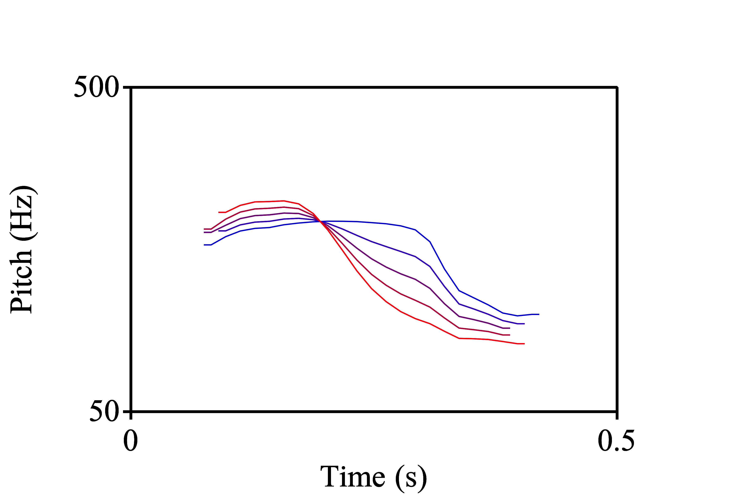
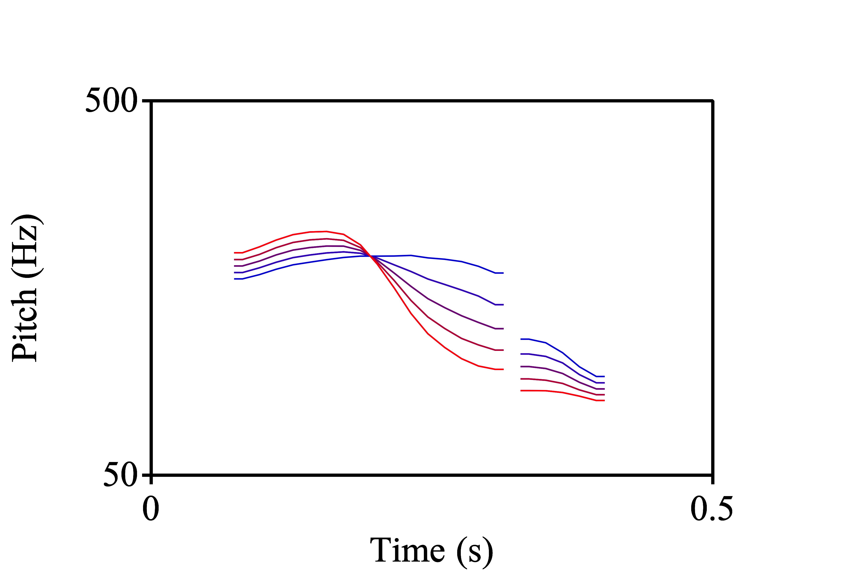
dur-4
toru-origin
tooru-origin

Slide 42
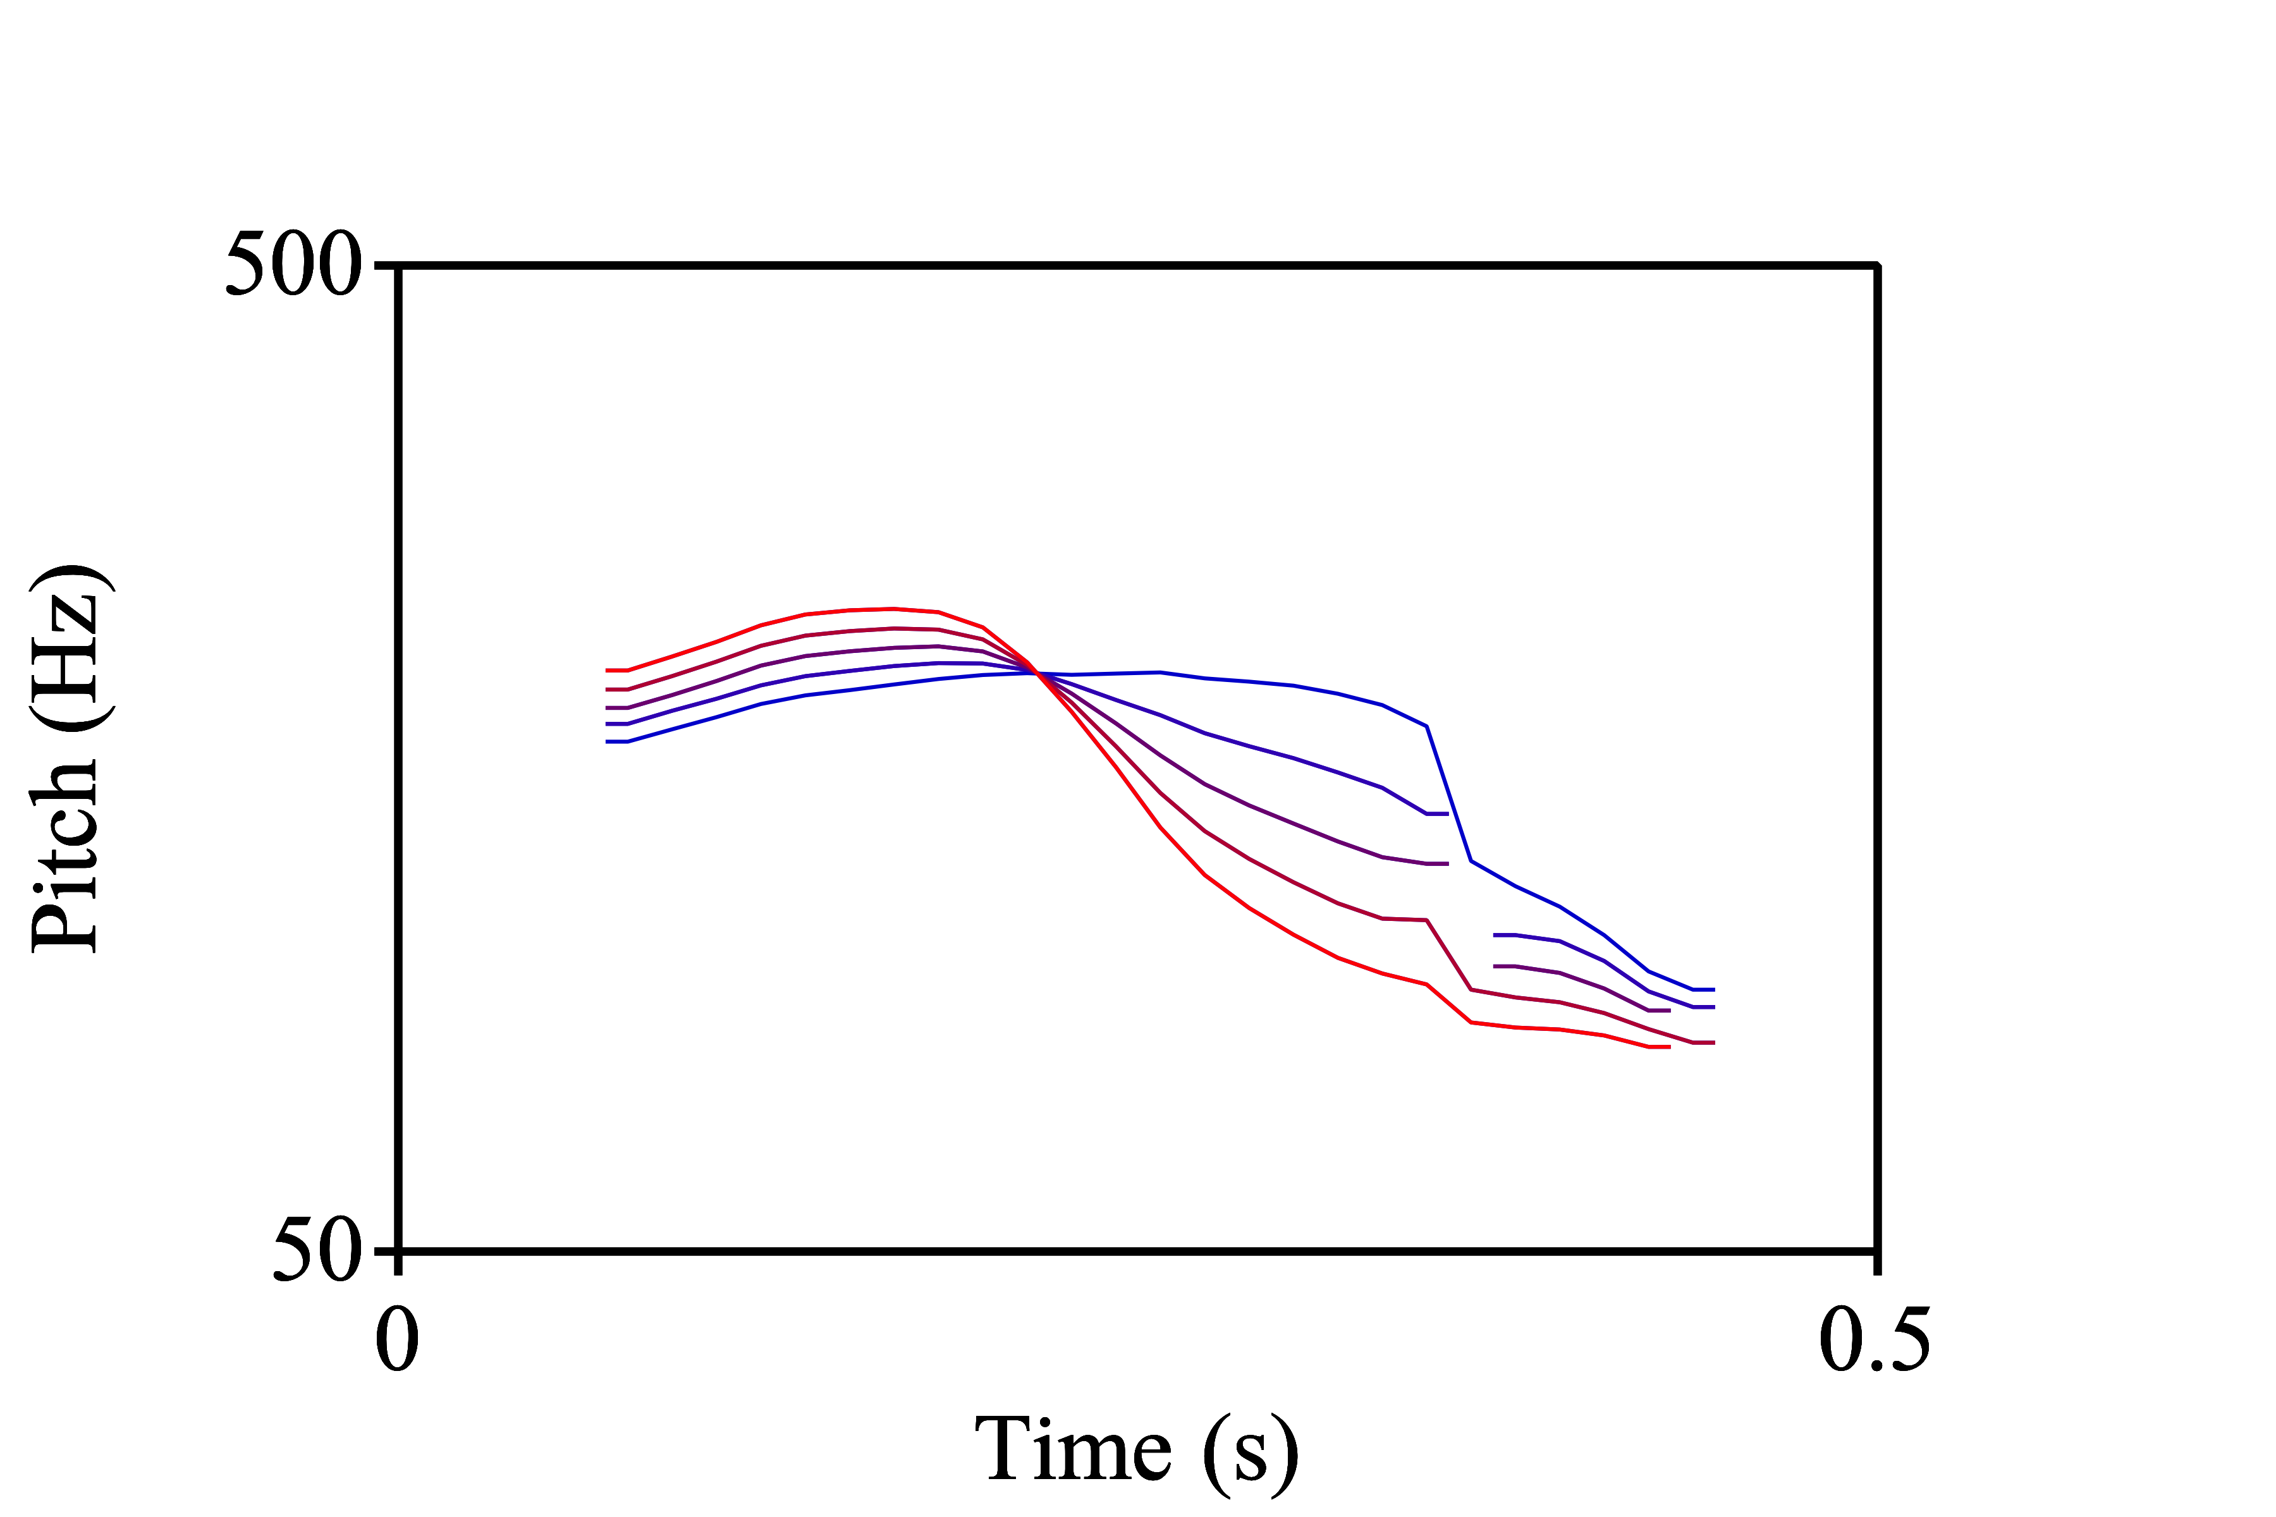
dur-5

Slide 43
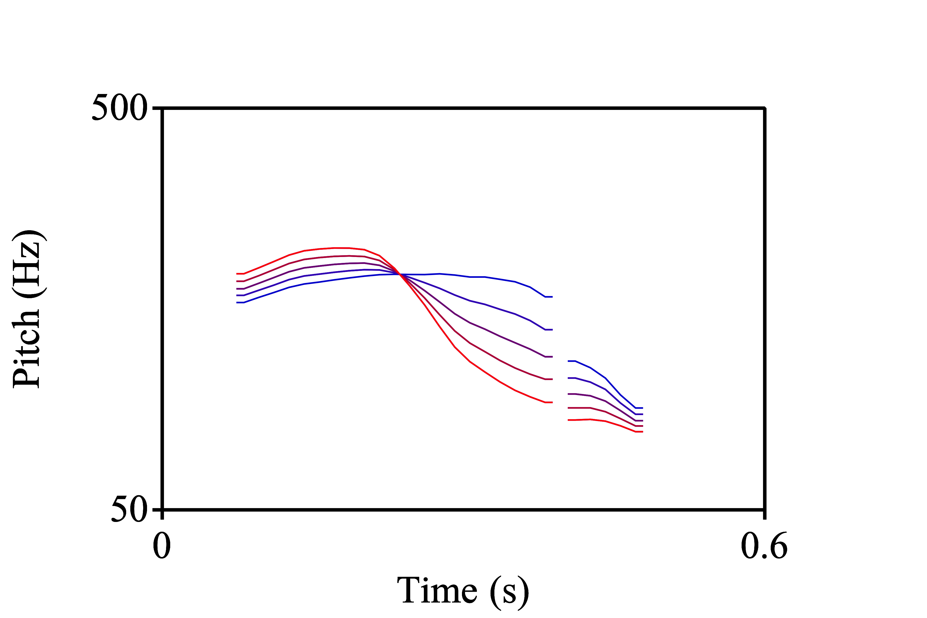
dur-6

Slide 44
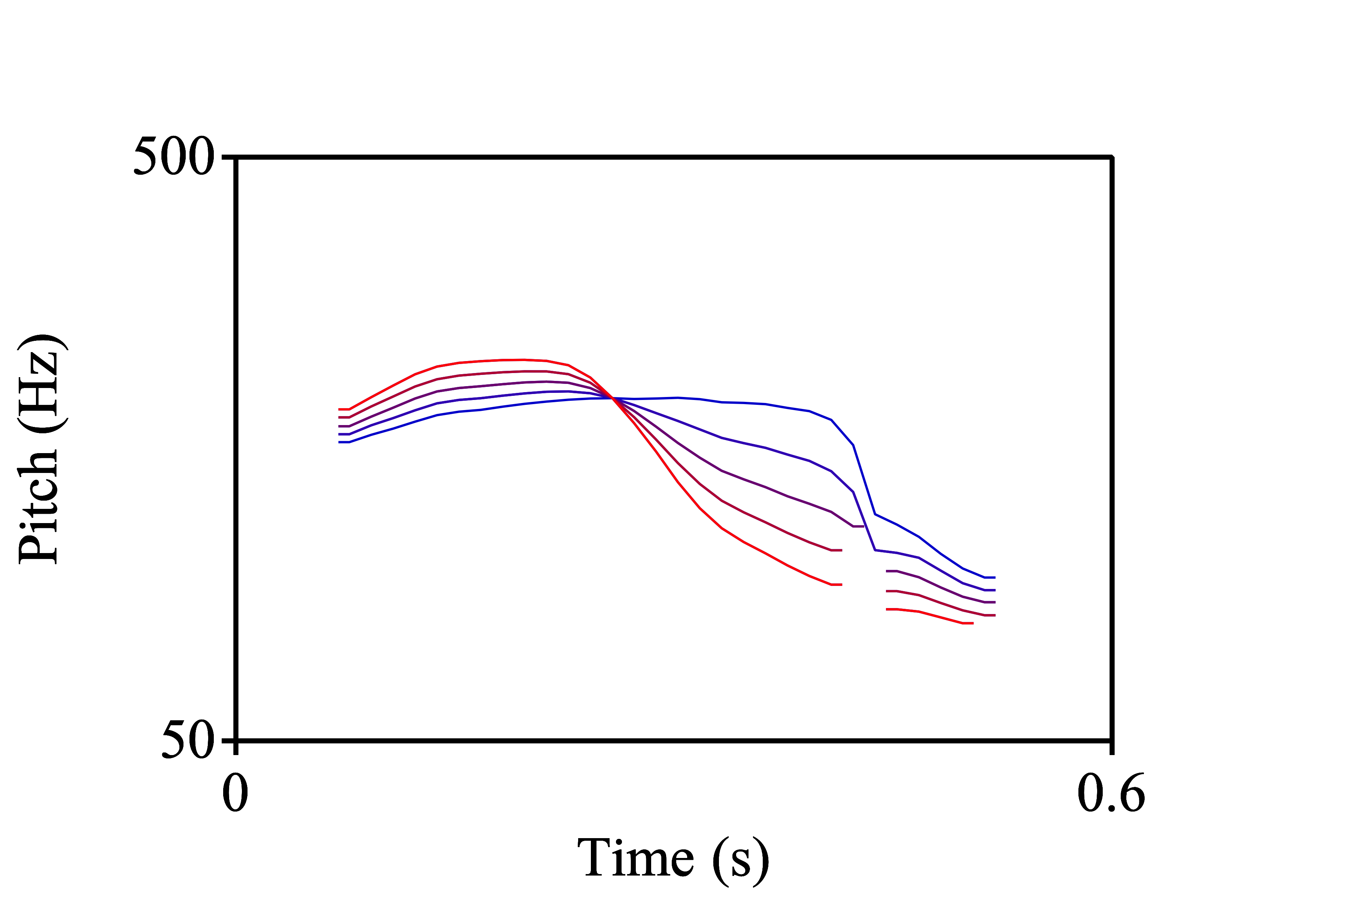
dur-7

Slide 45
toru [o] vs. tooru [oː]
Persisting considerations:
I could have added the creaky end back to the manipulated speech to make the end sound less abrupt
I should have excluded the formant transitions of the flap/tap [ɾ] from the duration manipulations

Slide 46
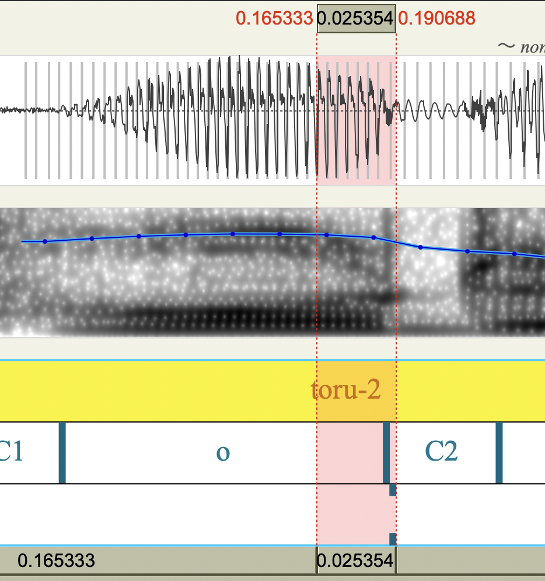
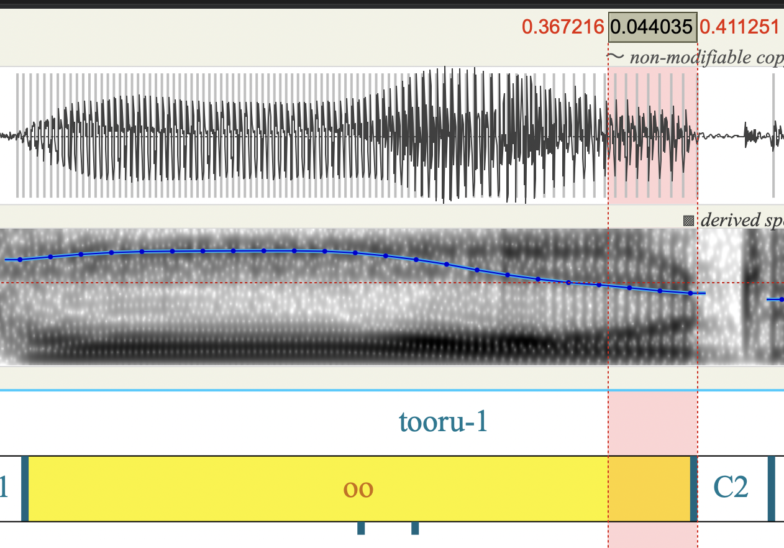
toru [o] vs. tooru [oː]

Slide 47
Praat scripting resources
Matt Winn website (with Praat scripts), Listen Lab GitHub (with more updated Praat scripts), ListenLab YouTube channel with Praat playlist (with demonstration of Praat scripts)
Webpage explaining PSOLA modification of speech from Charles University in Prague, Institute of Phonetics (primary Praat algorithm used to changed pitch and duration) from
SPEAC lab Praat scripts
Praat scripting tutorial website by Daniel Riggs
Phonetics on Speech Praat Scripting Tutorial online textbook by Dr. Jörg Mayer
Using Praat for Linguistics Research by Dr. Will Styler

Slide 48
Resources for synthesizing speech using other tools
TANDEM-STRAIGHT GUI tutorial by Annie Helms
STRAIGHT tutorial using MATLAB by Avery Ozburn
Another STRAIGHT tutorial using MATLAB by Michael McAuliffe
WORLD GUI tools for speech science tutorial using MATLAB by Hideki Kawahara

